Slide 1
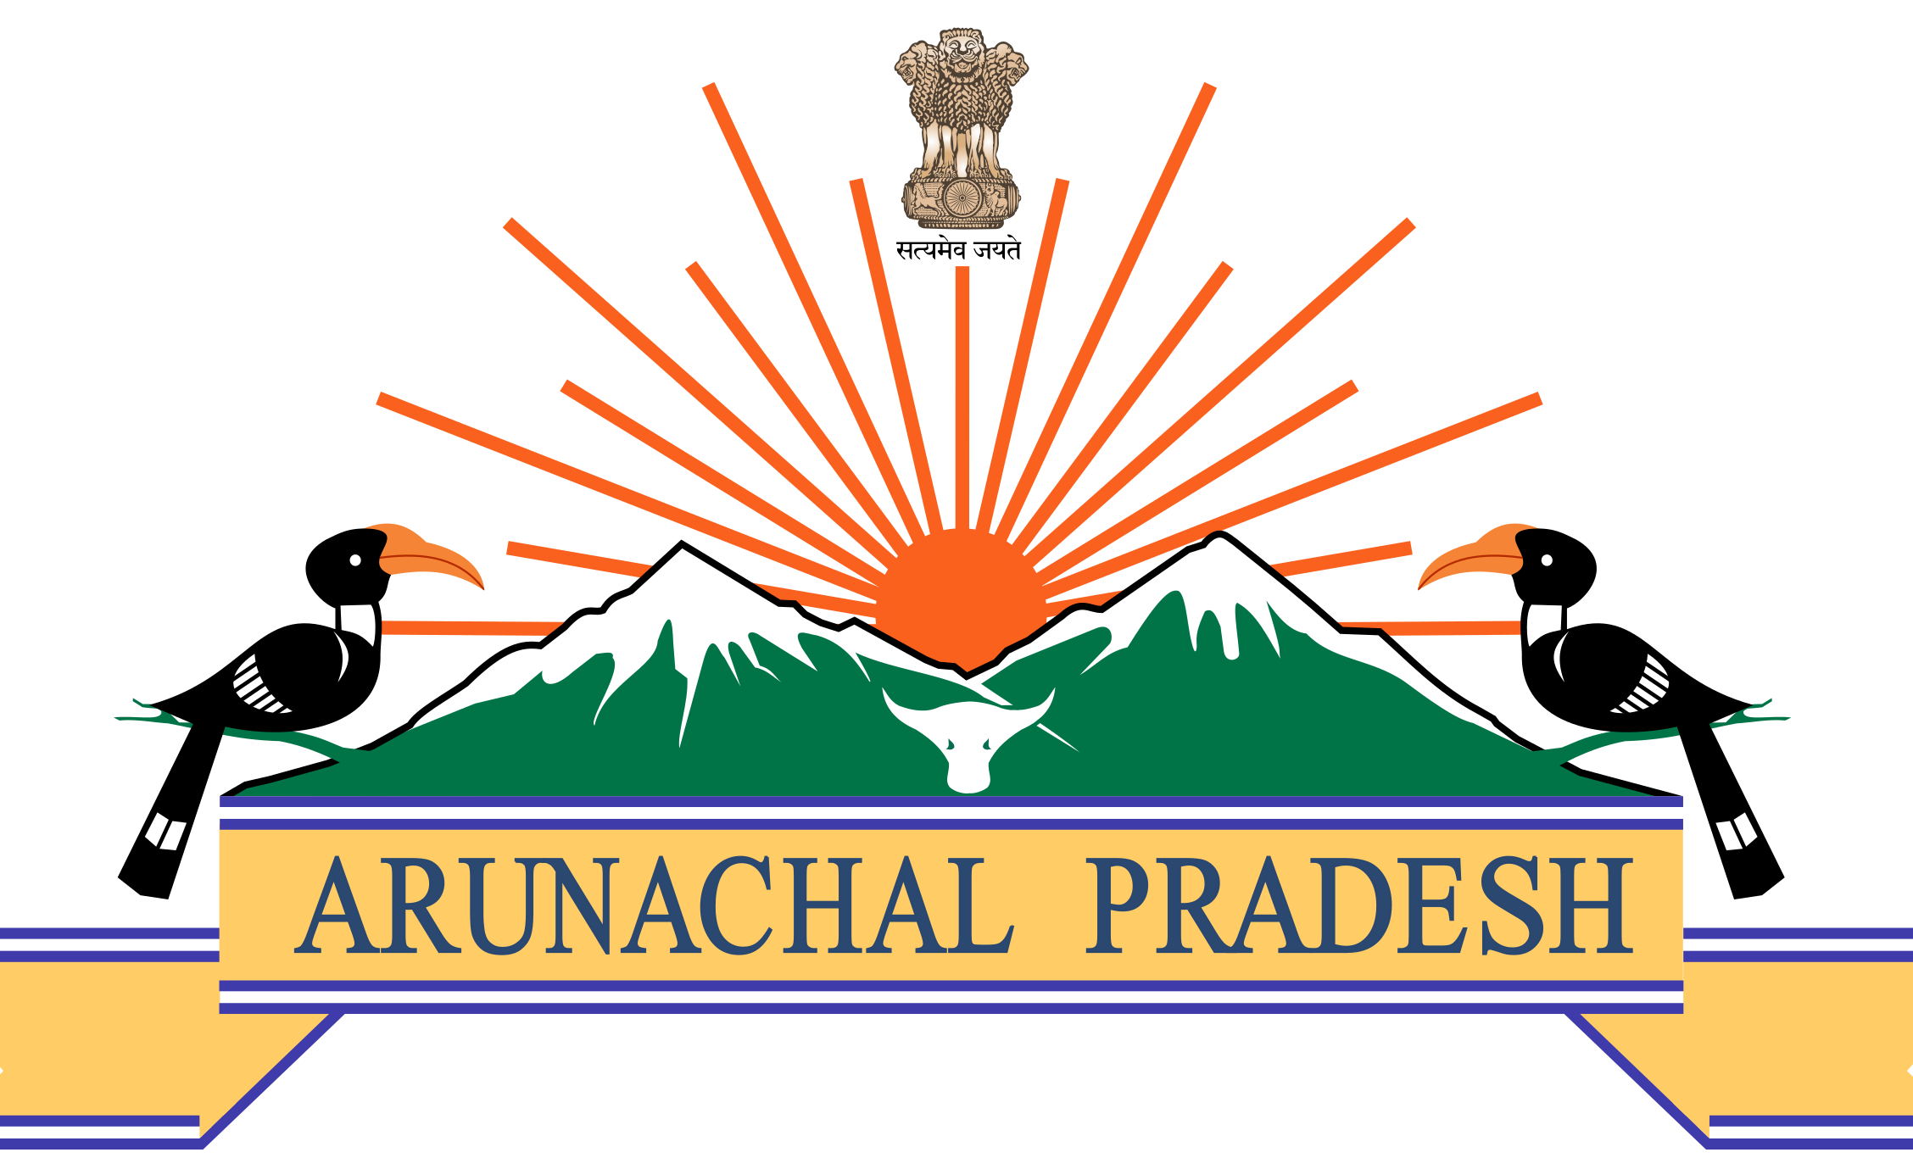

Languages of Arunachal
Ek Bharat Shrestha Bharat (EBSB)
NIT,Arunachal Pradesh
Presented by : Mudang Tubin
2nd Year : Civil Engineering

Slide 2
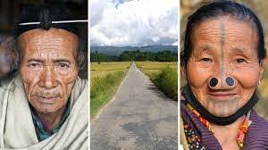
Apatani Language
Apatani’s live in Ziro Valley.
Native speakers: 44,815
Fervour for preservation & promotion of culture (including language)
Pops Sarmin society(School books)
Writing Apatani language proposed by ALDC(Apatani Language development committee)

Slide 3
“Language is the principal conveyer of understanding.”
–Dale Carnegie

Slide 4
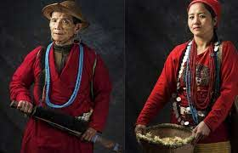
Bangni-Tagin Language
Tagin and Bangni(two dialects)
Native speakers:62,897
Calling ‘Dafla’ is a criminal offence by the constitution of India.

Slide 5
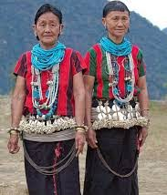
Bori Language
Bori(Adi) is a Tani language spoken in west Siang district.
It has major variations of sub groups. (Lexical tones)
Spoken by Bori people(indigenous tribe of the Adi people)

Slide 6
What is Tani Language?
Tani is a branch of Sino-Tibetan language family. It has the 2nd largest native speakers after Indo-European language family. It has an estimated of 1.3 billion speakers!

Slide 7
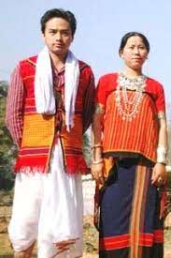
Chakma Language
It is an Indo-Aryan language which is a branch of Indo-European language family.
Officially it is not recognised by both the Bangladeshi Government or Arunachal’s Government.
Infamous PRC strike was against them.

Slide 8
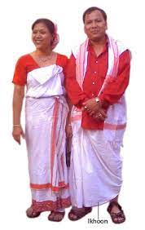
Deori Language
Spoken by Deori(water) people which are located at Lohit district.
It is a Tibeto-Burman language of the sino-Tibetian language family.
Di bongya tribe is the only one who retained this, others have shifted to Assamese.

Slide 9
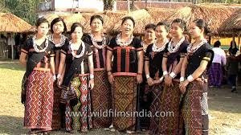
Digaro Mishmi Language
Ethnicity : Mishmi People,which have 3 sub groups : Idu Mishmi, Digaro, Miju Mishmi (Division due to geography)
Spoken in Lohit & Dibang Valley district.
Language Family : Sino-Tibetian

Slide 10
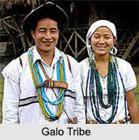
Gallong Language
Gallong(Galo) Language is a Sino-Tibetan/Trans-Himalayan Language of the Tani group spoken by Galo people.
Dialects of Galo:Pugu(central Aalo); Lare(South of Aalo); kargu kardi(northwest near Tagin area).
Additional unresearched dialects.
Two primary lexical tones:High & Low.
Taught as a third language in schools.

Slide 11
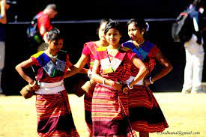
Hajong Language
It is an Indo-Aryan(Indic) language which is a branch of Indo-Iranian which is further the branch of Indo-European.
First it was Tibeto-Burman which is a Non-sinitic(Chinese) member of Sino-Tibetan language family.
Written in Bengali-Assamese and Latin scripts.

Slide 12
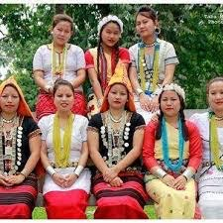
Hindi Language
One of two official Language of India with English.
It is an Indo-Aryan langauage.
Written in Devanagari script.
It is and official language in 12 states along with 3 union territories.
Hindi is the fourth most spoken language in the world after Mandarin,Spanish and English.

Slide 13
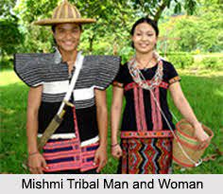
Idu-Mishmi Language
Idu-Mishmi(Simplified Chinese) is spoken by Mishmi people.
Spoken in Districts: Dibang Valley,Lower Dibang Valley,Lohit,East Siang and Upper Siang,
It was using Tibetan script to write but now they have adopted Idu-Azohra Script.
It is considered to be an endangered language with only 11,000 native speakers in both India and China.

Slide 14
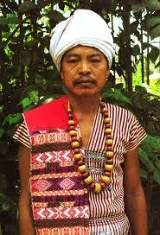
Karbi Language
Spoken by Karbi people(Also known as Mikir or Arleng).
Language family: Sino Tibetan; Kuki-Chin-Naga branch.
In A.P. They can be found in Balijan circle.

Slide 15
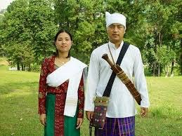
Khamti Language
It is a south-western Tai Language spoken by Khamti people(Tai ethnic group)
Can be found spoken in Namsai & Changlang district.
Writing system: Lik Tai.

Slide 16
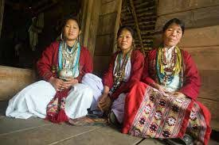
Koro Language
A Sino-Tibetan Language.
Spoken by a small group in the East Kameng District.
Native speakers: 1500

Slide 17
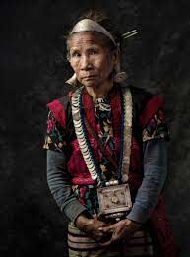
Miju Language
Long considered to be a Sino-Tibetan language but it is now considered to be a Language Isolate(A Language with no demonstrable genealogy).
Ethnicity:Miju Mishmi
Spoken in Lohit district.

Slide 18
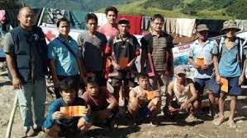
Milang Language
Milang comes from Siangic or Tani language family of the much broader Sino-Tibetan language family.
Spoken in Upper siang district.
Namely in 3 villages (Milang,Dalbing & Pekimodi)
Native speakers:2000
Milang Village

Slide 19
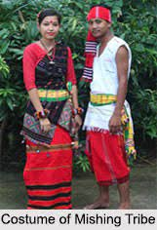
Mising Language
Mising/Mishing also as Plains Miri is Tani Language.
Spoken by Mising(Miri) people.
East siang,Lower Dibang Valley,Lower subansiri(Ziro division), Upper Subansiri(Daporijo sub-division)
Uses Roman script for writing.

Slide 20
Nefamese Language
Nefamese/Arunamese is pidgin/lingua Franca Language which in simple terms means common language,trade,bridge or link language.
It is a language used to make communication possible between groups who do not have a native/associated language.
It is now somewhat replaced by Hindi.

Slide 21
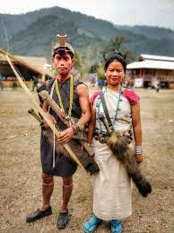
Nyishi Language
A Sino-Tibetan language of the Tani branch.
It is spoken in the districts: Papum pare,Lower Subansiri,Kurung Kumey,Kra Daadi,East Kameng,Pakke Kesang & Kamle.
Plenty of variations across regions with dialects such as Akang,Aya,Raga Nyishi,Mishing,Tagin.
Native Speakers: 3,00,000 approx.

Slide 22
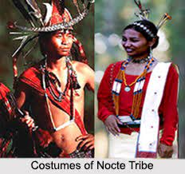
Nocte Language
It is a Northern Naga Language(A branch of Sino-Tibetan).
Spoken in districts: Khonsa,Tirap,Changlang.
Alternate names: Borduria,Jaipuria,Mohongia,Namsangia,Nocte,Paniduria.
It has many dialects.(around 9)

Slide 23
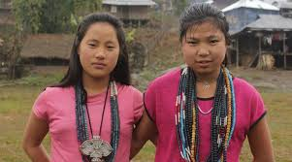
Tangam Language
Endangered Sino-Tibetan language of Tani sub-group.
Native speakers:150-260
Spoken in Kuging village,Tuting in upper Siang district.
They are hills tribe people but due to there close associations with Memba people of Tibet, some Tibetan cultural traits have been adopted too.

Slide 24
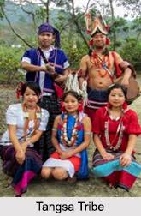
Tangsa Language
Tangsa/Tare/Tase Naga is a Sino-Tibetan Language.
Spoken by Tangsa people of Burma.
Spoken in Tirap and Changlang districts.
There are many sub division of dialects.

Slide 25
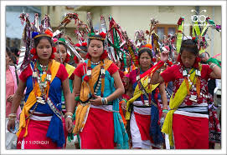
Tutsa Language
Tutsa is a Sino-Tibetan Language.
Spoken in southern Changlang district & Eastern Tirap district.
Ethnicity: Tutsa Naga( closely related to Tangsa)

Slide 26
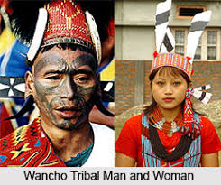
Wancho Language
It is a Konya Language(Northern Naga) which is a branch of Sino-Tibetan Language family.
Spoken in Lohit & Longding district.
Alternate names: Banjara Naga,Joboka,Jokoba.
Written in Latin as well as Devanagari script.
There are 4 dialects along with significant variations depending upon their geographical location.

Slide 27
Yano Language
Yano is Tani Language.
Possibly a variety of Nishi.
Thank you for your patience.

