Slide 1
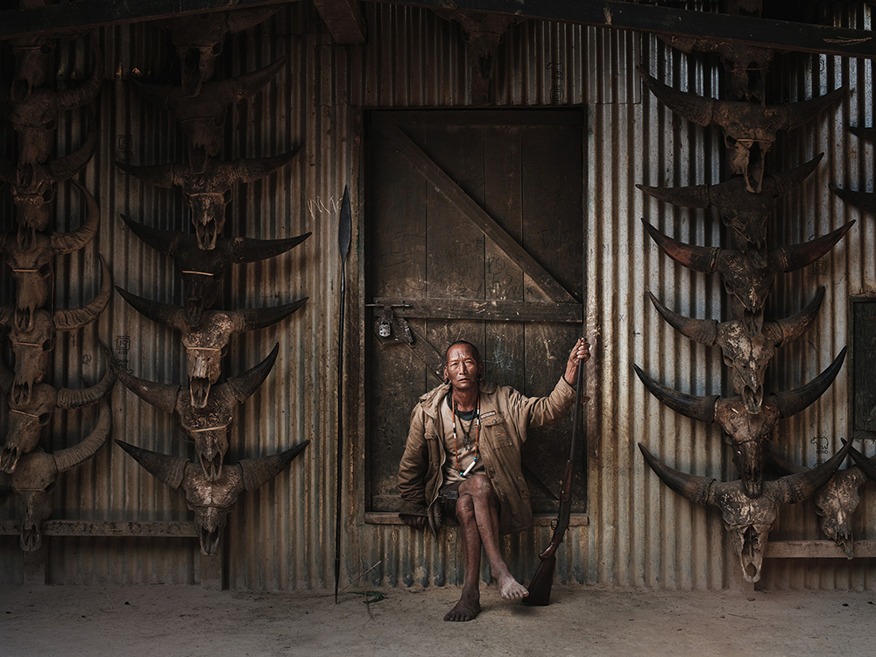
History of Arunachal Pradesh
Dr. Rubu Tani
Assistant Professor
Department of History
Dera Natung Government College, Itanagar, Arunachal Pradesh, India
Email: obingtani@gmail.com

Slide 2
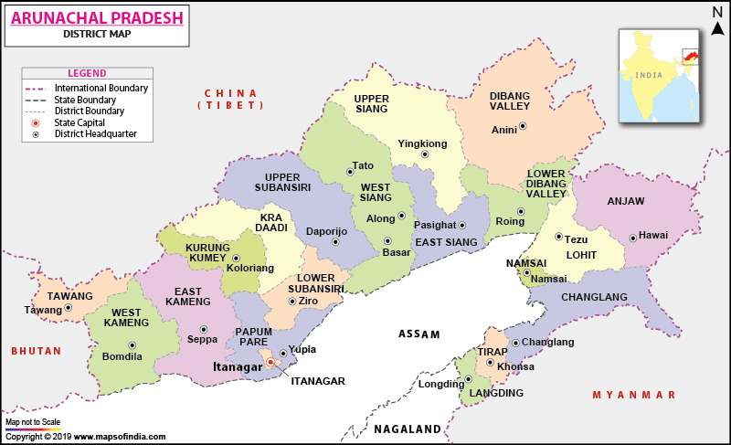
Brief Profile

Slide 3
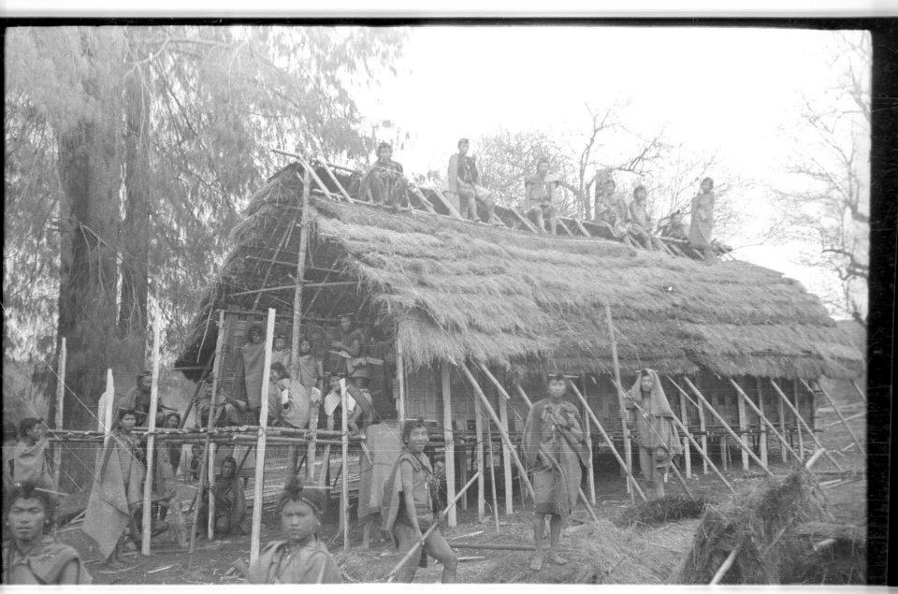
Land and People
Racially people are affiliated to Indo-Mongoloid race and linguistically affiliated to Tibeto-Burman.
There is no state language. People use either Hindi, Assamese, English and local dialects for communication.
People follow Shamanism, Animism, Buddhism, Hinduism, Christianity, Donyi-Poloism, and Islam.
Do not have own written scripts, except Buddhist communities that too confined to Monastic use only.
Therefore, we have to dependent on various sources to understand the history of the state.

Slide 4
SOURCES OF ARUNACHAL PRADESH

Slide 5
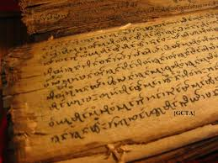
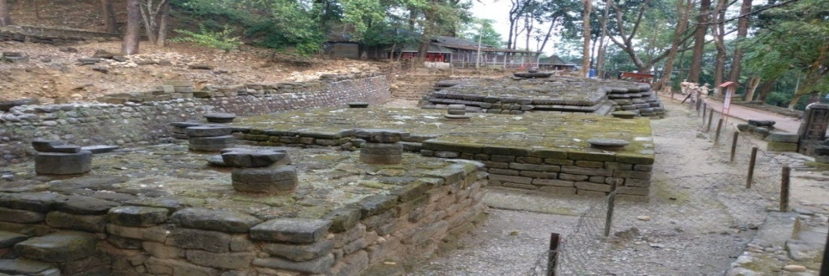
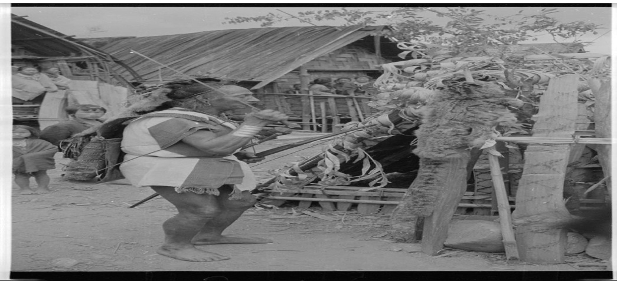
Sources of History of Arunachal Pradesh
Literary Sources:
Religious Texts.
Travellers Account
Ahom Buranjis.
Colonial accounts
Archaeological Sources:
Excavation.
Inscription.
Monuments.
Oral Sources:
Folklore
Folktale
Myth
Legend, etc.

Slide 6
ORIGIN AND MIGRATION

Slide 7
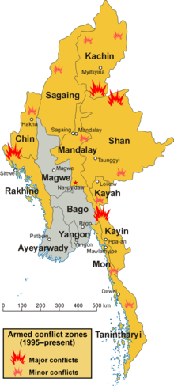
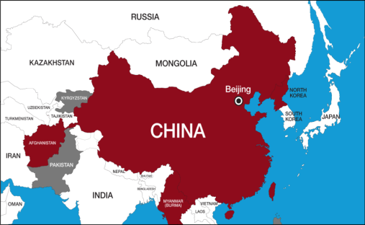
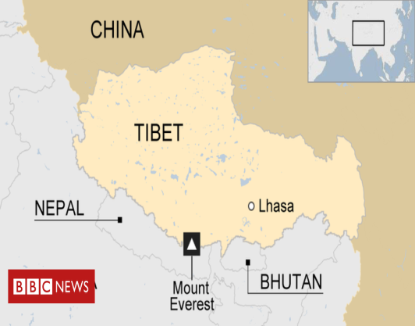
Origin and Migration
Eastern Zone:
Khamti, Singpho, Tangsa, Wancho, Nocte and Yobins, etc.
Migrated from Burma (Myanmar)
Central Zone:
Adis, Galos, Nyishis, Apatanis and Tagins, etc.
Migrated from China and Tibet
Western Zone:
Monpas, Mijis, Akas, etc.
Migrated from Bhutan and Tibet.

Slide 8
SOCIETY AND CULTURE

Slide 9
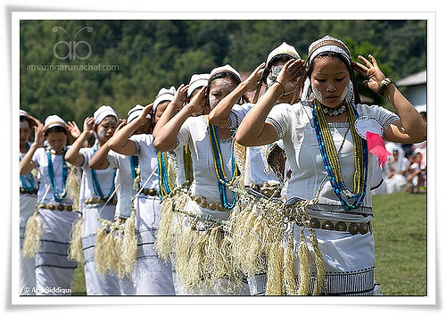
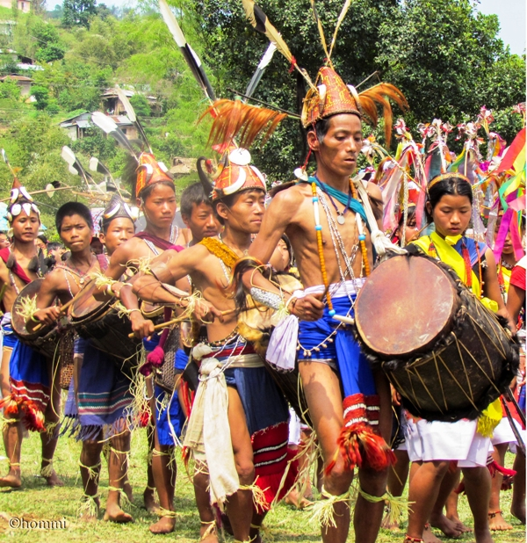
Society and Culture
Tribe endogamy and clan exogamy.
Patriarchical society.
Nuclear and joint family.
Inheritance: (a) Immovable property to sons and (b) Movable property to daughters.
Festivals are mostly related to agriculture.
Dance are of different forms: a) Festival dance, (b) Ritual dance, (c) Recreational dance (d) Pantomime dance (e) War dance.
Marriage are of different types- Love, Arrange, Force, Elopement, Abduction, Raid and Counter Raid etc.
Female did not enjoy equal status in social, political and religious affairs of the society.
No social evil like sati, purdha, child infanticide, dowry, widow etc. were present.

Slide 10
ECONOMIC LIFE

Slide 11
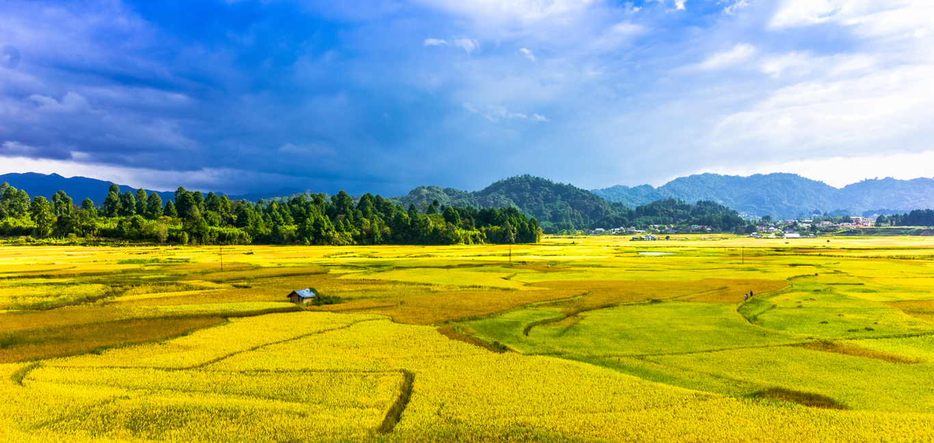
The Economic Life
Agriculture was the mainstay of their economy.
Both wet-rice and Jhum cultivation were practised.
Apart from agriculture people dependant on forest, rivers, streams, hunting, fishing, trapping, seasonal wild fruits, nuts, roots, edible leafs, medicinal plants, fish and meat, etc for their daily consumption.
Trade was another component of economy.
Absence of cash and exchange was done only through BARTER system.
Barter exchange within village, neighbour village, other tribal communities, people of Assam and cross-border trade, etc.
Some of the major supplies from hill were like various handmade crafts from wood, bamboo and cane, skin of animals, ivory, medicinal plants, rice.

Slide 12
RELIGIOUS LIFE

Slide 13
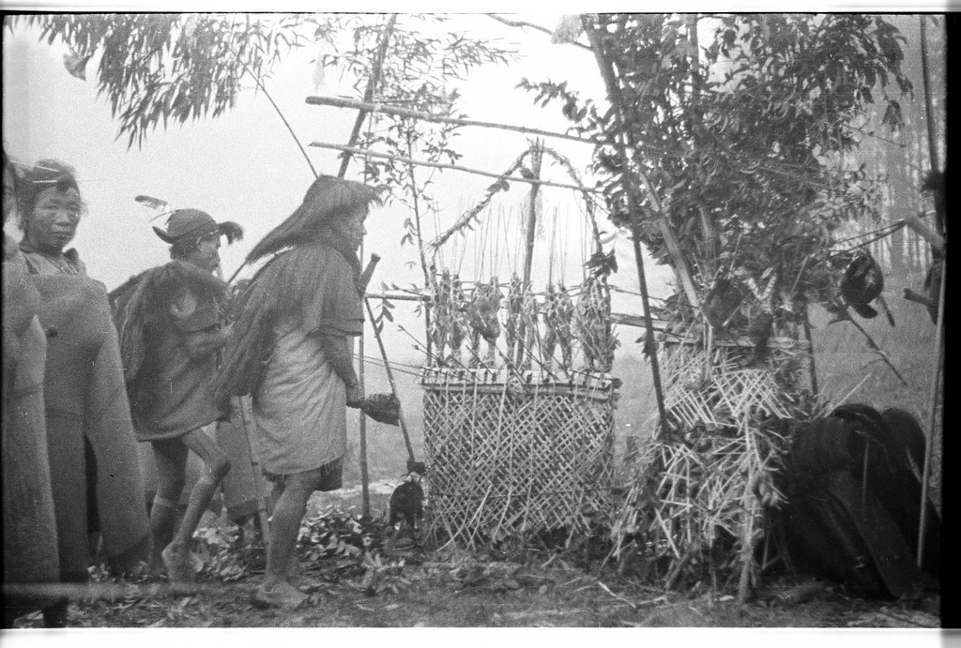
Religious Life
Hereditary Shamanism
Believes in number of spirits both good and bad.
Take help of Shaman (local priest) to negotiate with the spirits.
Rituals/Sacrifice/Offering to deities with the help of priest.
Nyishi, Apatani, Galo, Tagin and Mishmi, etc.
Animism:
Believes in numbers of spirits.
Believes that one can not influence these spirits but can appease with the help of priest.
Rituals/Sacrifice/Offering are made to appease the spirits.
Nocte, Wancho, Tangsa
Buddhism:
Mahayana- Bigger Wheel (Monpa, Memba and Khamba)
Hinayana- Smaller Wheel (Khamti and Singpho)

Slide 14
Traditional Administration and Political Institutions

Slide 15
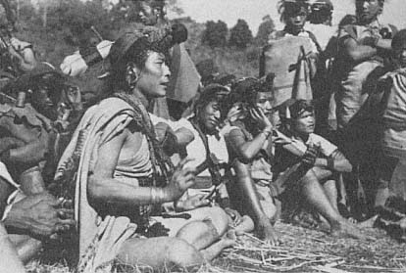
Traditional Administration and Political Institutions
Chieftainship System:
Khamti, Singpho, Tangsa, Nocte, Wancho.
Republic or Democratic Type:
Adi : Kebang – (Dolung, Bango and Bogum Bokang)
Apatani: Builyang – (Akha, Yapa and Hime)
Temporary Type:
Nyishi, Tagin and Mishmi (Nyle)
Theocratic Type:
Monpas (Monastry control appoint and control over the head member of village council)

Slide 16
AHOM RELATIONS WITH THE HILL TRIBES

Slide 17
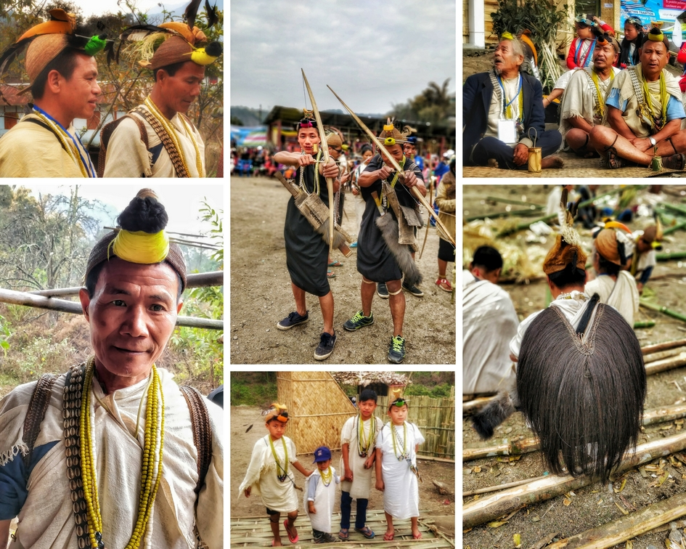
Ahom Relations with the Tribes of A.P
Posa System:
Annual exchange between Ahom and the hill tribes.
Received commodities which were not available in hill like salt, iron, cloth, rice, cotton, etc.
Bring down commodities from hill- medicinal plants, animal skins, various crafts made from bamboo and bats, rice, ivory, Tibetan and Burmese swords, etc.
In return, hill tribes accept to maintain peace and tranquillity in foothill areas.
Ahom never tried to extend their territorial control over the hill of Arunachal Pradesh.

Slide 18
BRITISH RELATIONS WITH THE HILL TRIBES

Slide 19
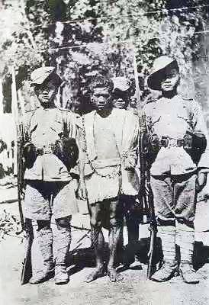
British Relations with the Tribes of A.P
English annexation of Assam in 1826 after the Anglo-Burmese War.
Disrupted in existing Ahom-Tribal relations.
Posa was converted from kind to cash.
Several resistance by hill tribes like Khamti in
1839, Singpho in 1843, Akas in 1835, Adis in 1911-12.
The interaction between hill and plain were regulated
through Inner Line Regulation of 1873.
1882 Assistant Political Officer were appointed to
look after the affairs of hill tribes.
In 1914 Arunachal Pradesh was divided into
three section- Eastern, Central and Western Sections
under each political officer.
1914 renamed as the North East Frontier
Tract.
1947 Indian got Independence.

Slide 20
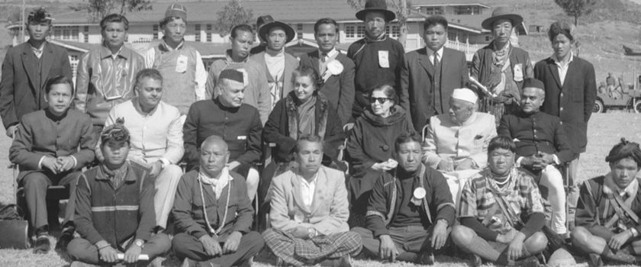
Administrative Development after 1947

Slide 21
Administrative Development after 1947
Debate: Isolation, Forceful Assimilation, and Slow-Integration.
Jawaharlal Nehru and Verrier Elwin advocated for policy of slow integration.
1954 renamed as the North East Frontier Agency.
Nehru-Elwin policy of slow assimilation was followed till 1962 Chinese Aggression.
Policy of forceful assimilation through sending military, opening roads, helipads, government offices, school, etc.
1972 declared as Union Territory of India and renamed as Arunachal Pradesh by then prime minister Indira Gandhi.
1987 declared as the full fledged Statehood of India.

Slide 22
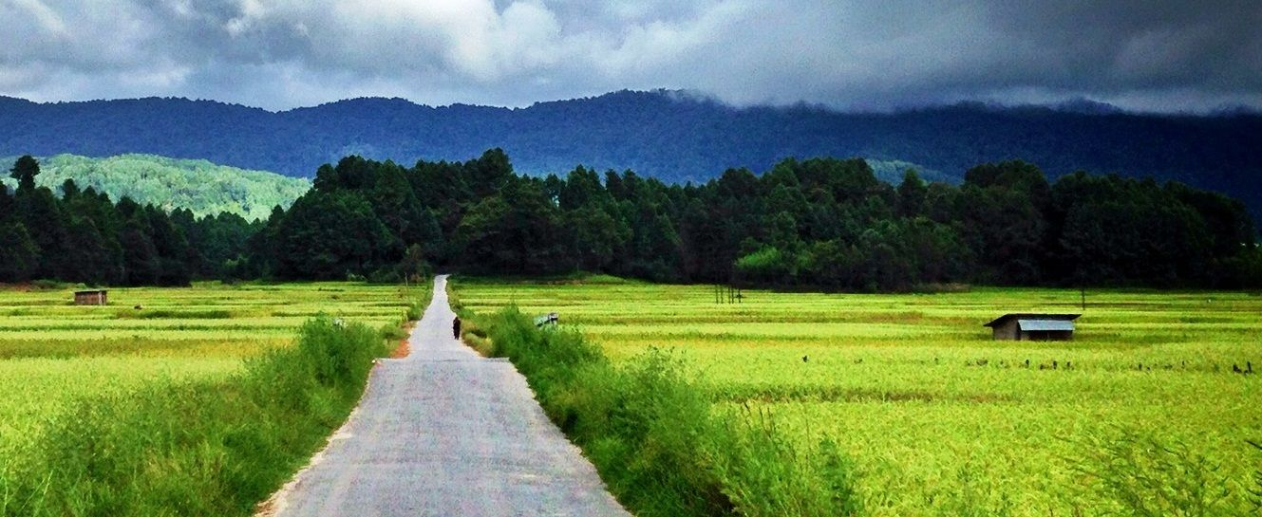
Thank You

