Slide 1
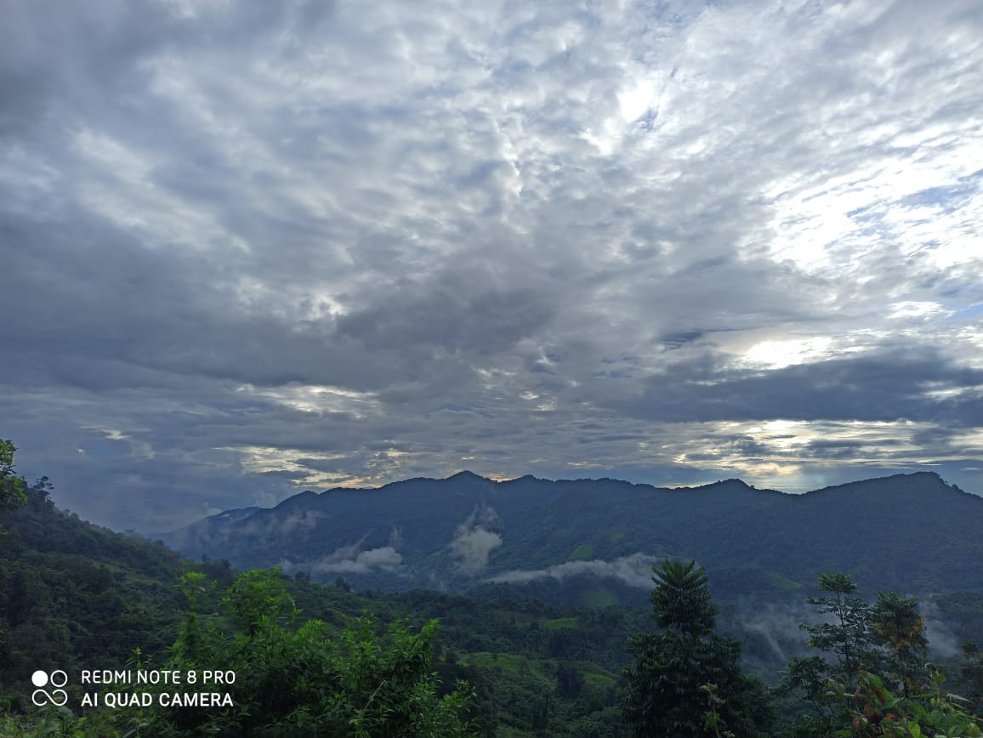



uuuuuhuhuh

Slide 2


Slide 3
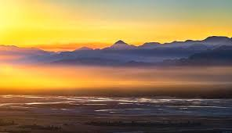


Slide 4

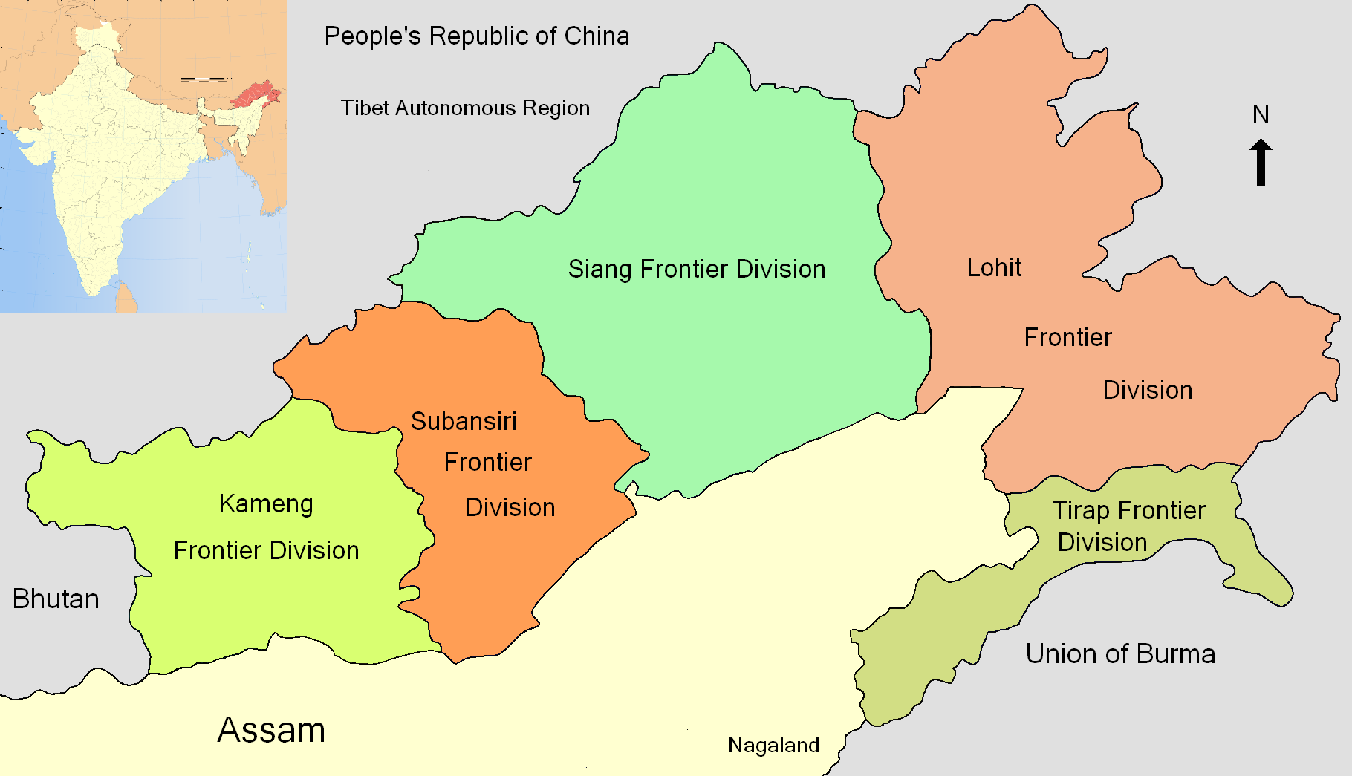
EVOLUNARY MAP OF ARUNACHAL PRADESH
On 20th of Febraury,1987, Arunachal Pradesh became a state with 5 districts : Kameng , Subansiri, Siang, Lohit and Tirap.

Slide 5
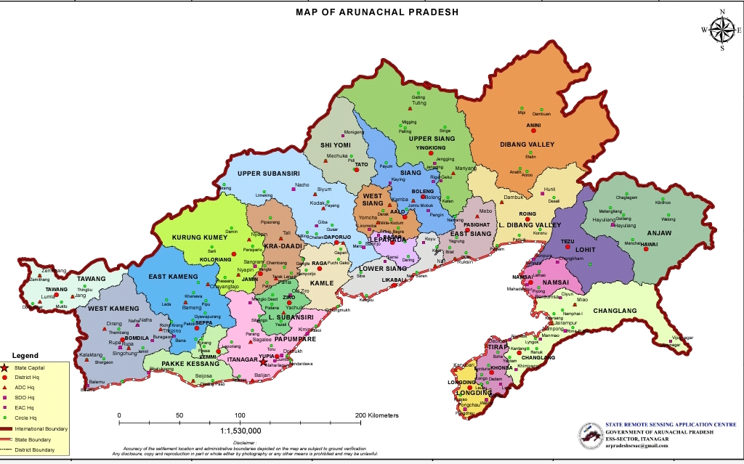
NEW MAP OF ARUNACHAL PRADESH:
Currently here are 25 district.

Slide 6

THE EMERGING ARUNACHAL PRADESH
ENTREPRENEURS AND STARTUPS

Slide 7

PUBLIC SERVICE PROVIDING APPS
TRIP TO ANYWHERE
HUNGRY JI
Dukan dada
U Tell Us
MeeBuddy

Slide 8

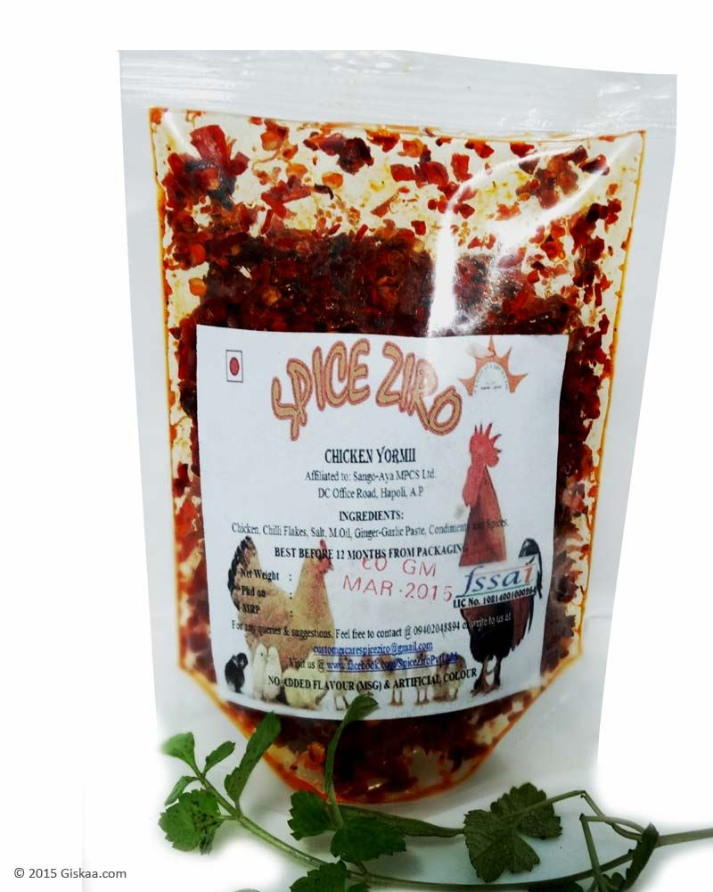
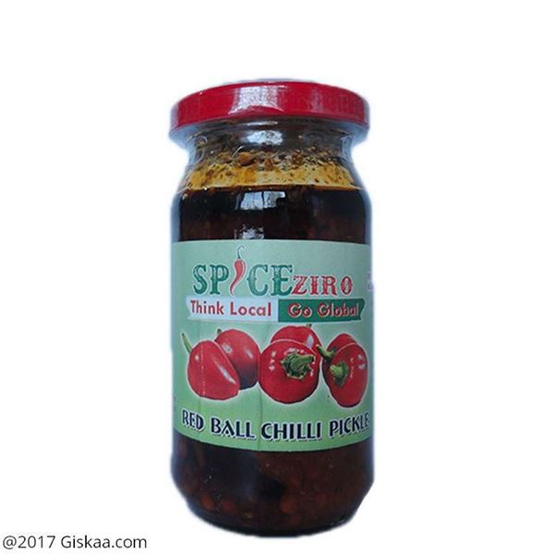

ENTREPRENEURS
SPICE zIRO
NAARA-AABA,WIKI WINE

Slide 9
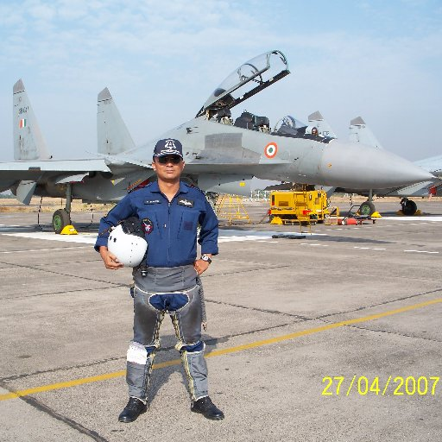
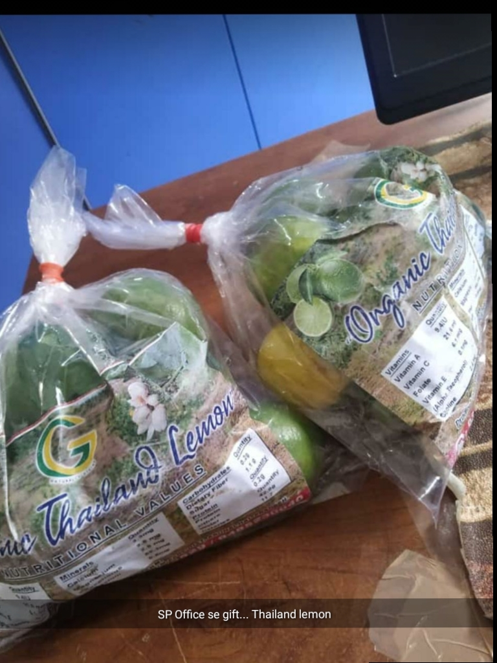
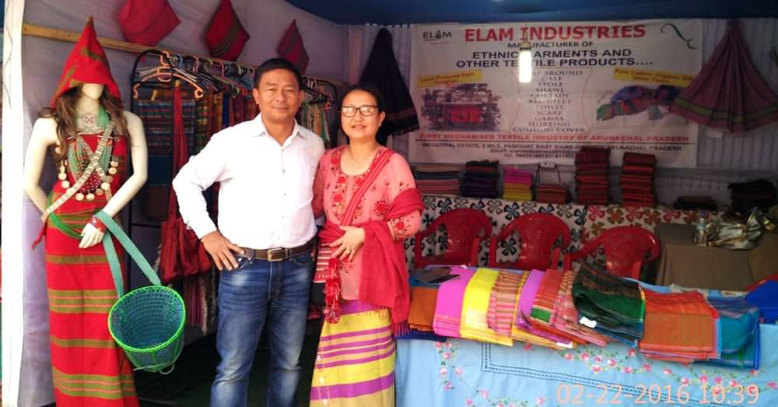
RETIRED WING COMMANDER OF IAF,AN ALIMINOUS OF NDA, MR MOHANTO PANGING SETUP ELAM INDUSTRY IN 2015 AT PASIGHAT.
ORGANIC THAILAND LEMON

Slide 10
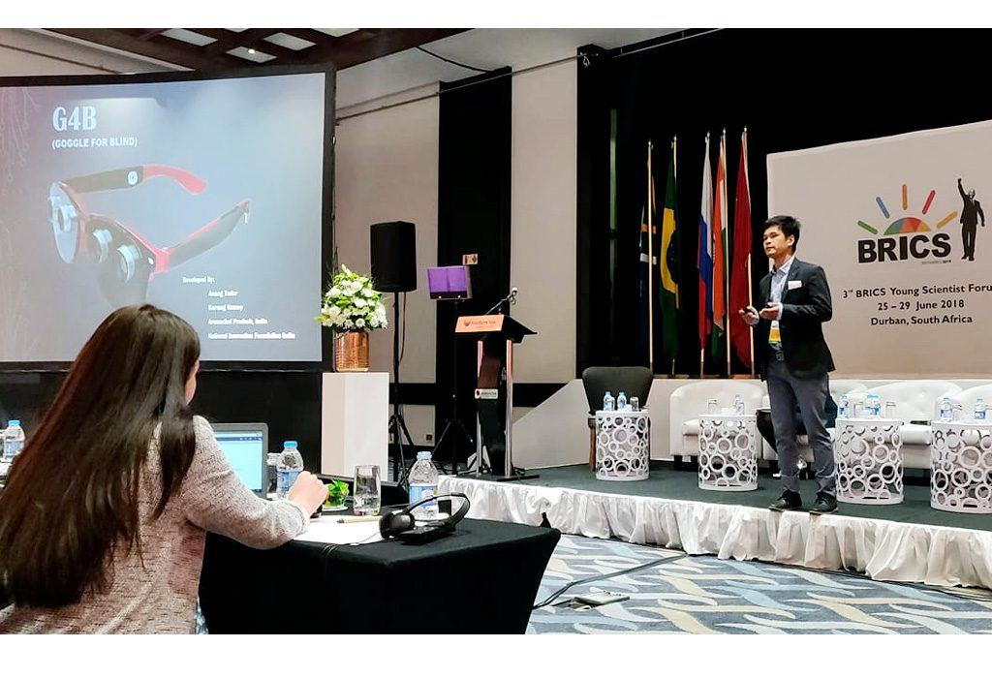
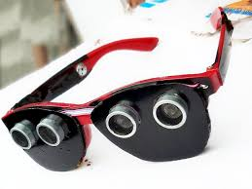
ANANG TADAR,
G4B

Slide 11


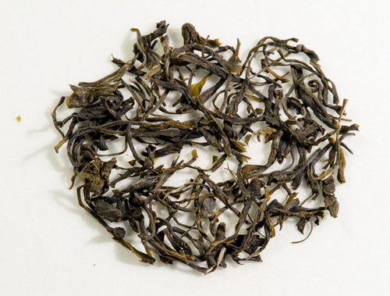
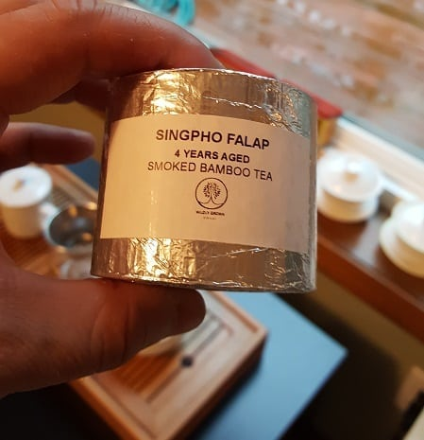
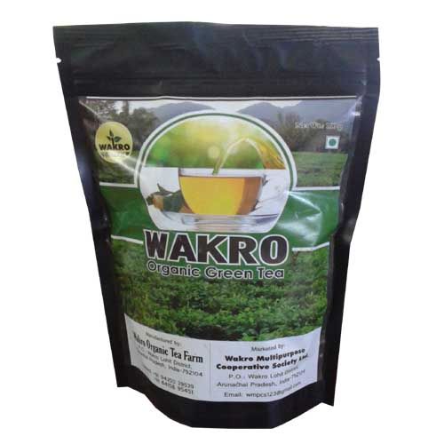
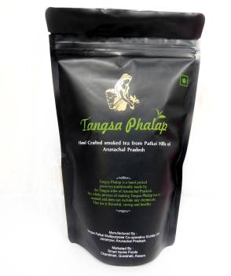
ORGANIC GREEN TEA
DONYI POLO TEA ESTATE
RIOING SRING TEA

Slide 12

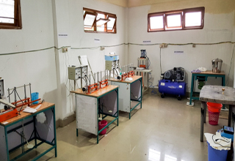
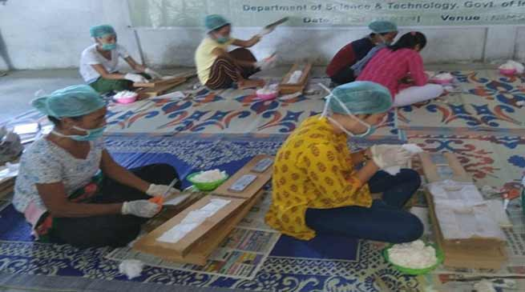
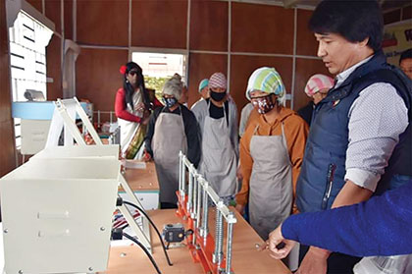
TRAINING AND PRODUCTION OF
SANITARY NAPKINS

Slide 13
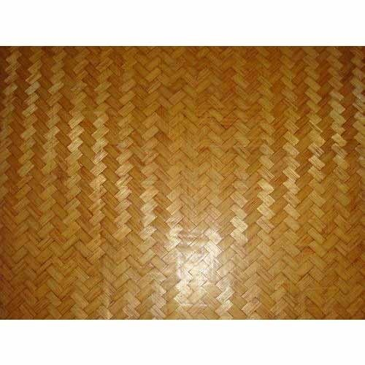
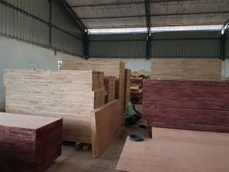
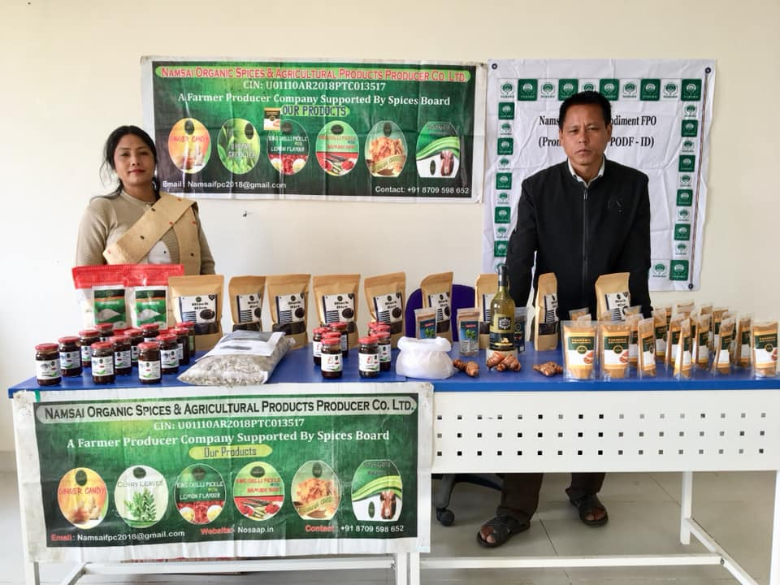
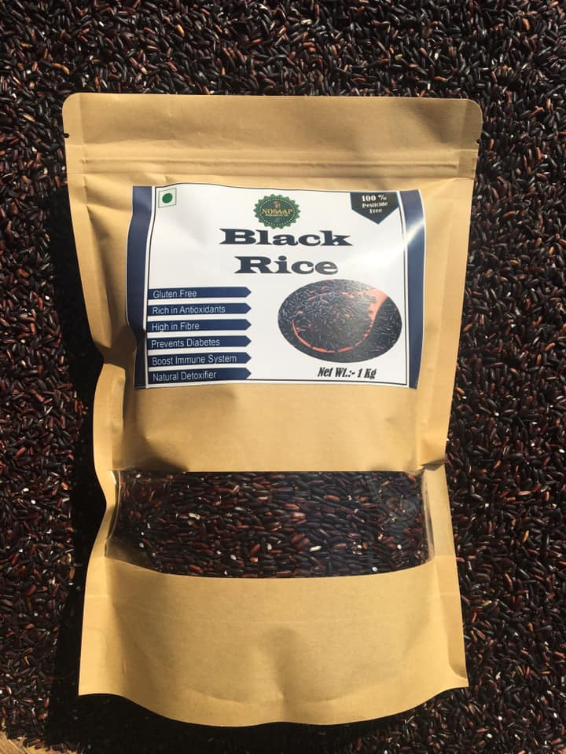
PLYWOOD PRODUCTION
BAMBOO PLYWOOD
NAMSAI ORGANIC SPECIES AND AGRICULTURE PRODUCT COMPANY LIMITED

Slide 14

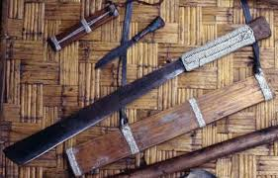

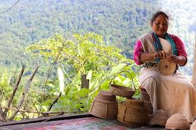
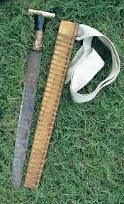
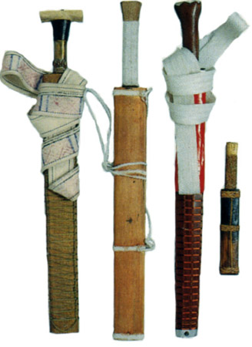
ARTEFACTS

Slide 15
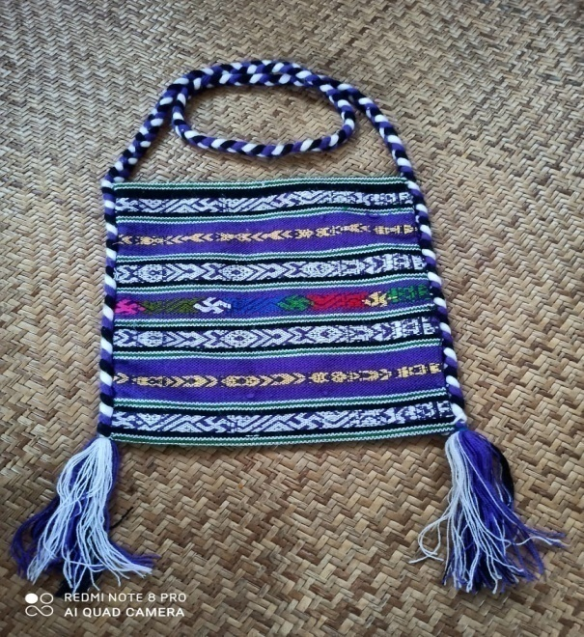
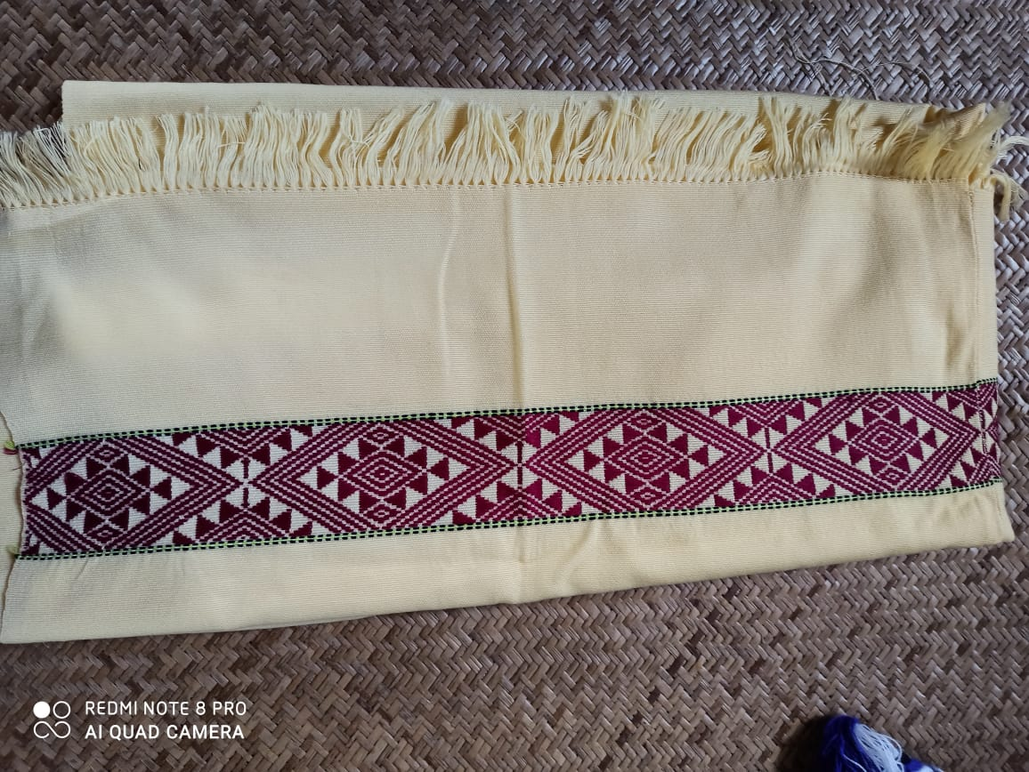
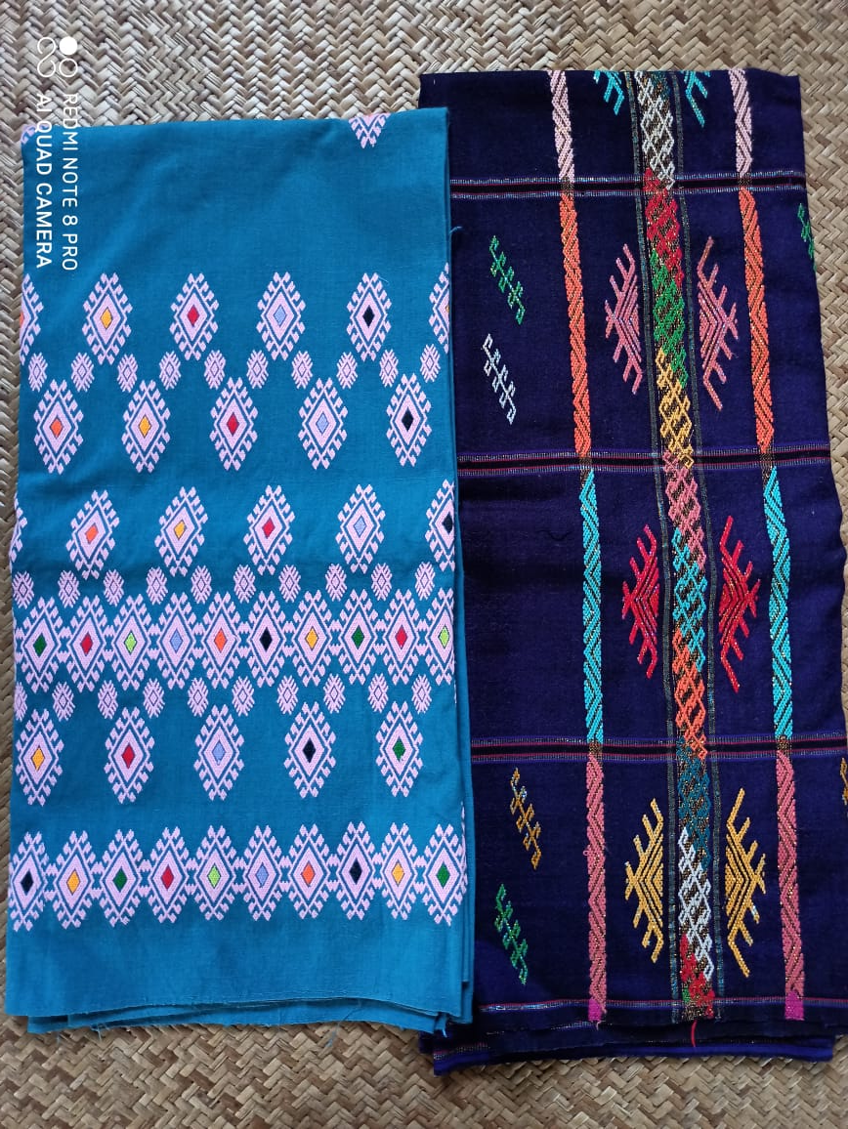
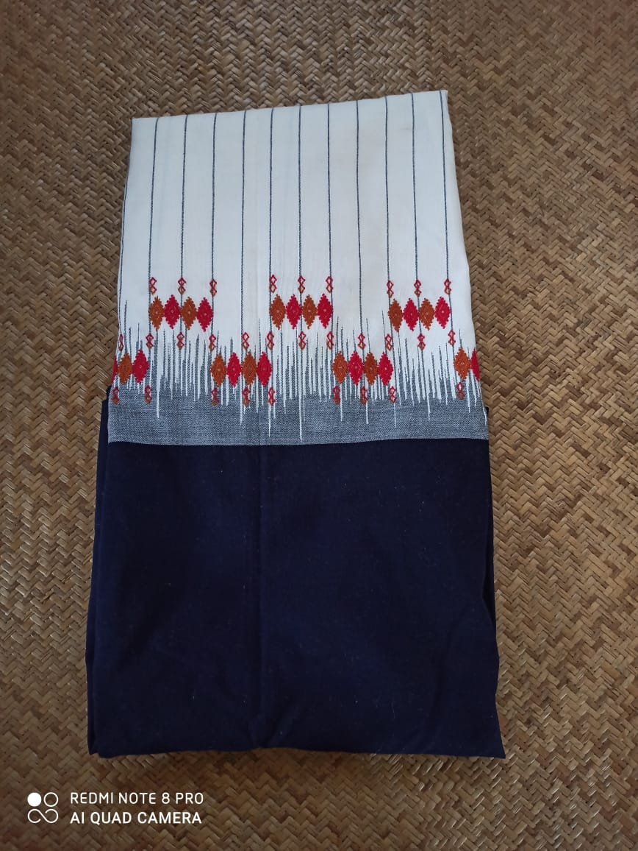
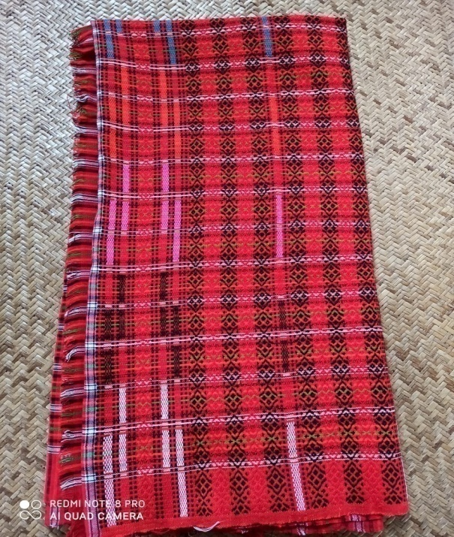
TAI-KHAMTI-SINGPHO BAG
NOCTE GARMENT
SINGPHO GARMENT
APATANI GARMENT
MISSING GARMENT

Slide 16
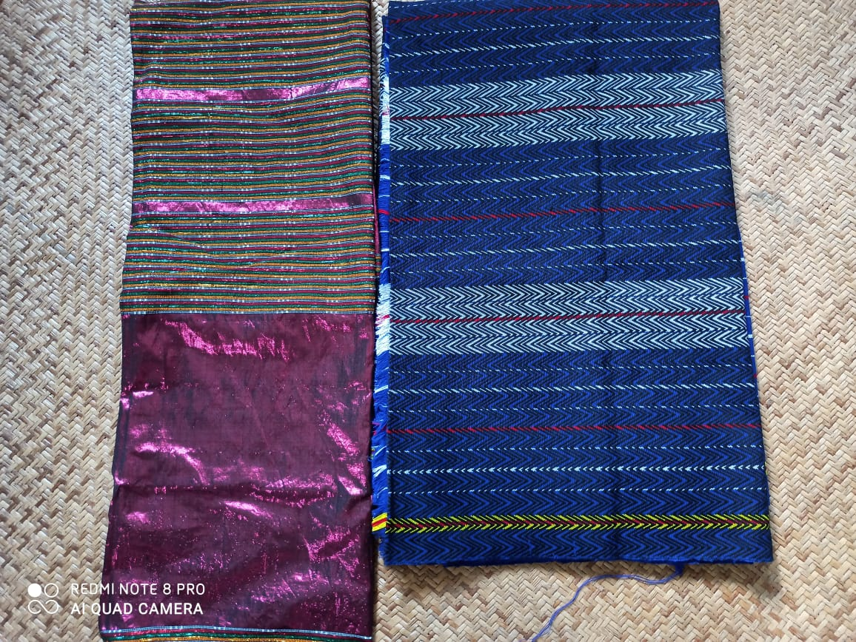
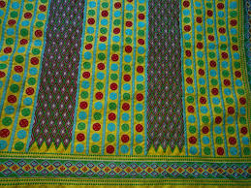
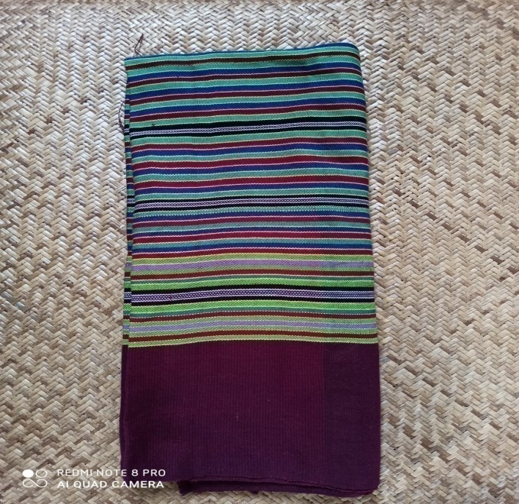
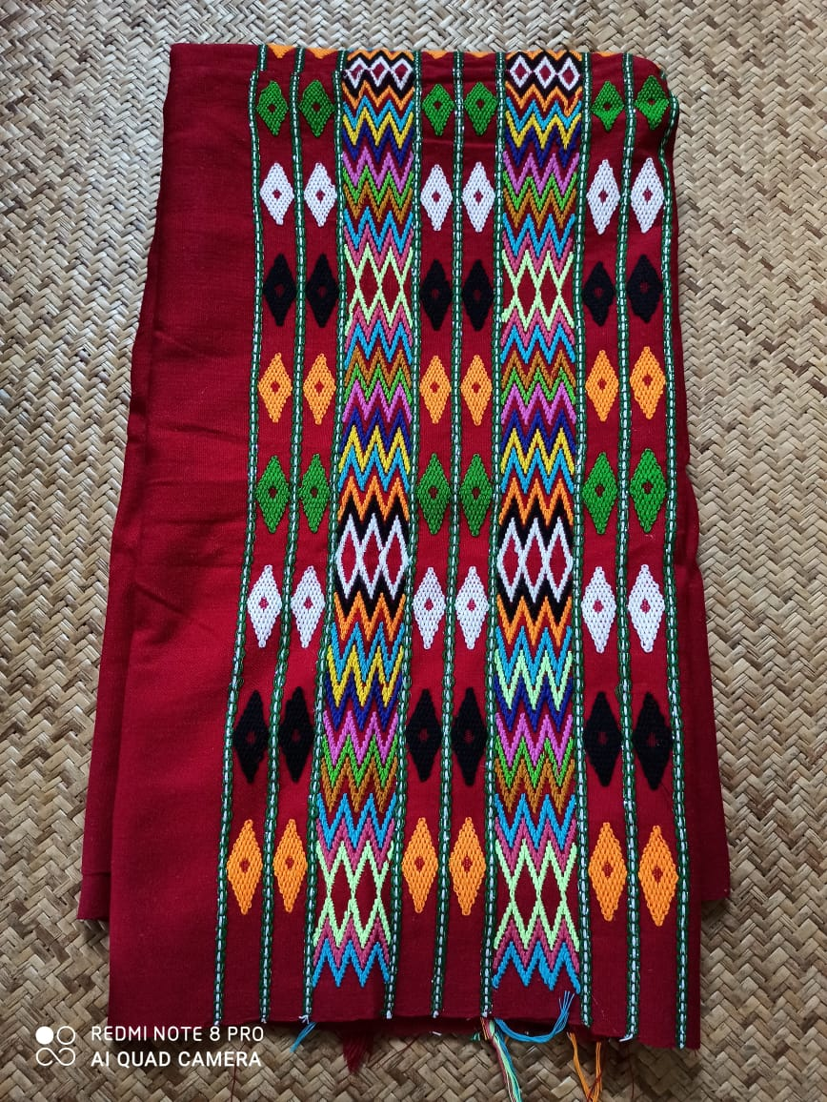
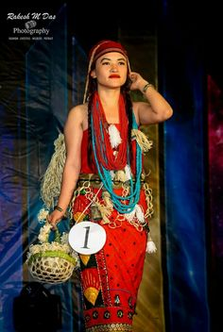
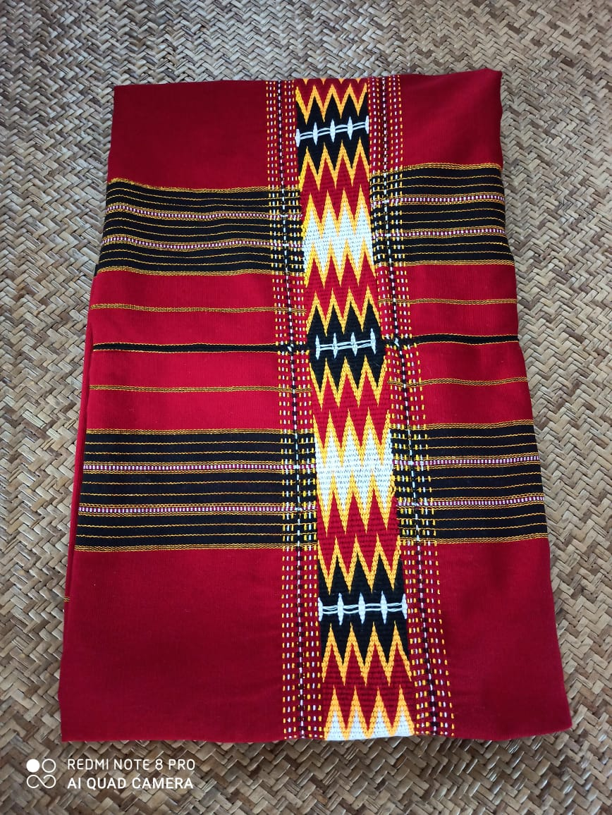
TANGSA GARMENT
NYISHI GARMENT
MISHMI GARMENT
WANCHO GARMENT
TAGIN ATTIRE
ADI GARMENT

Slide 17
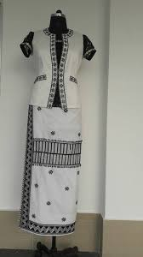
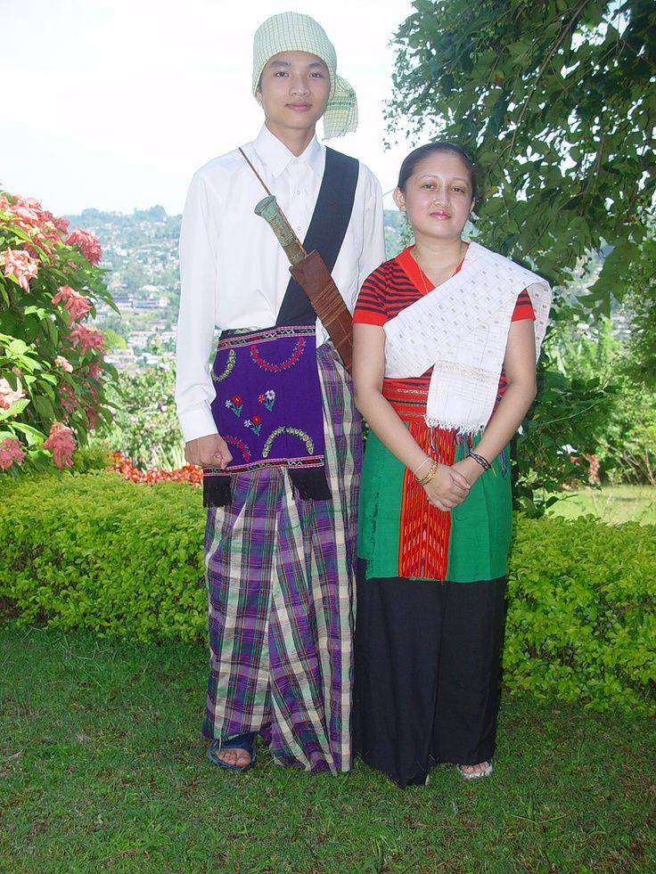
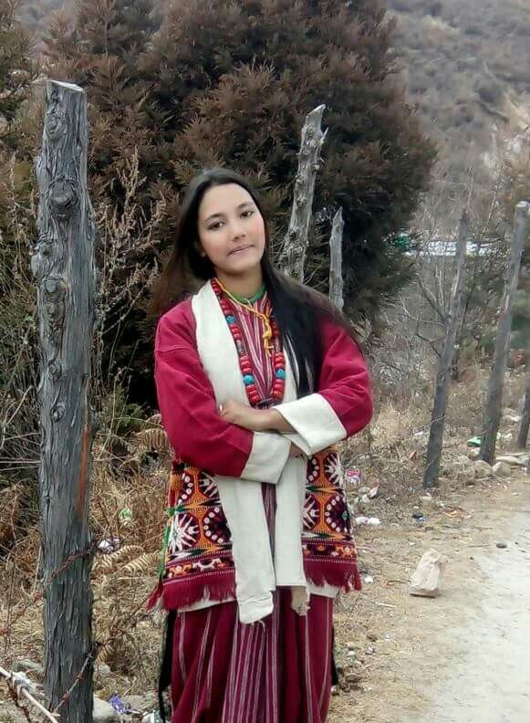
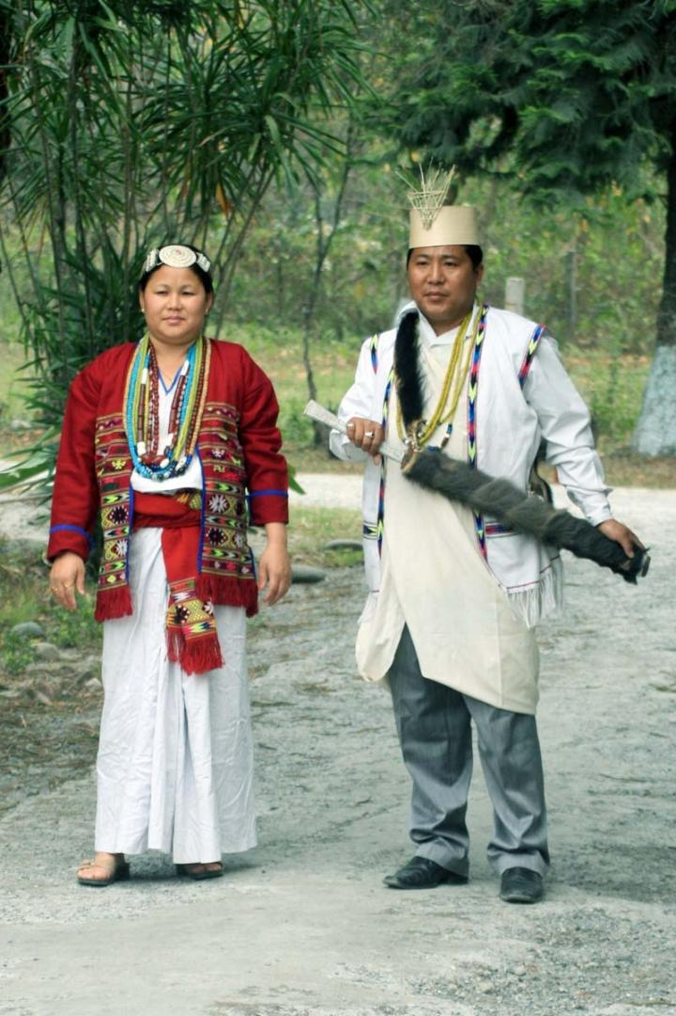

GALO GARMENT
KHAMTI ATTIRE
MONPA ATTIRE
AKA ATTIRE
CHAKMA ATTIRE

Slide 18

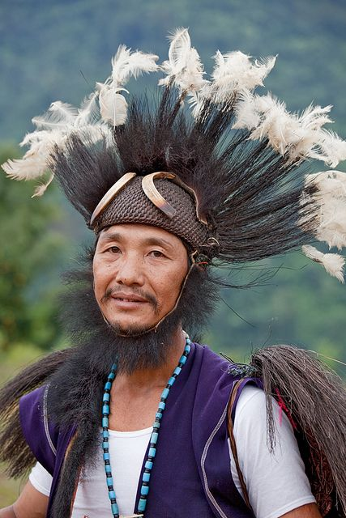
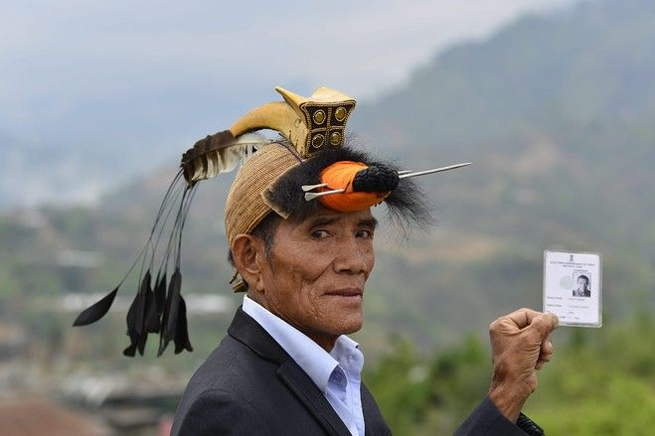
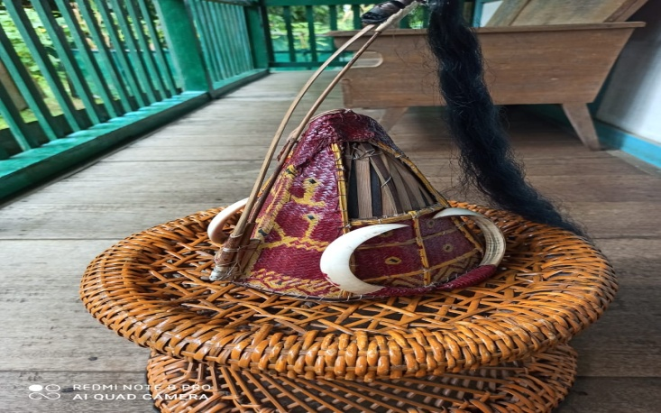
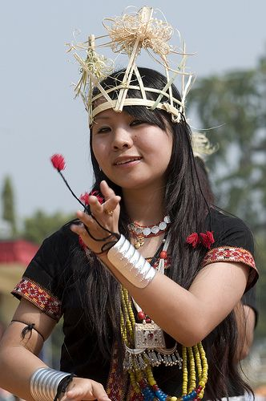
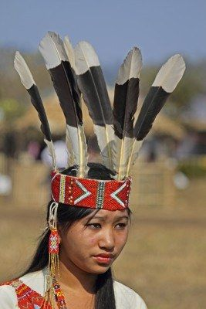
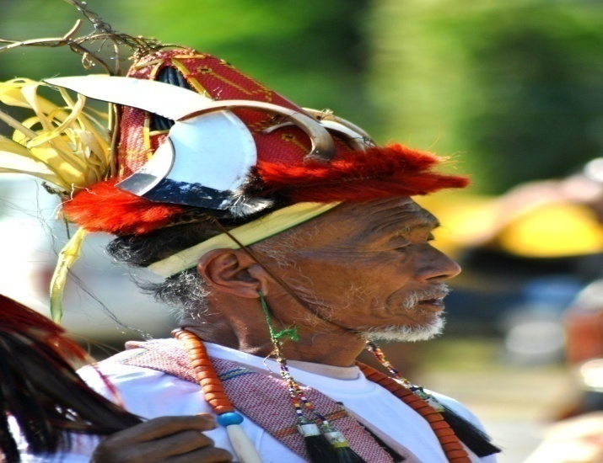
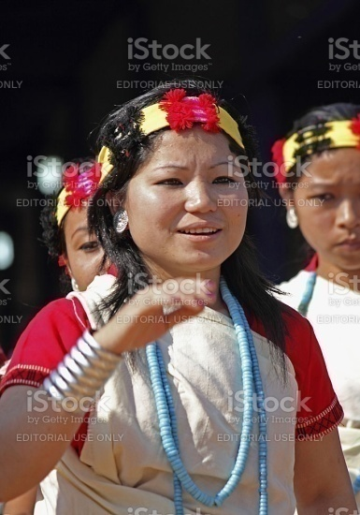
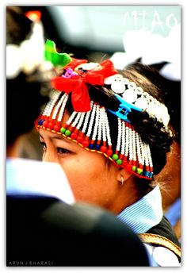
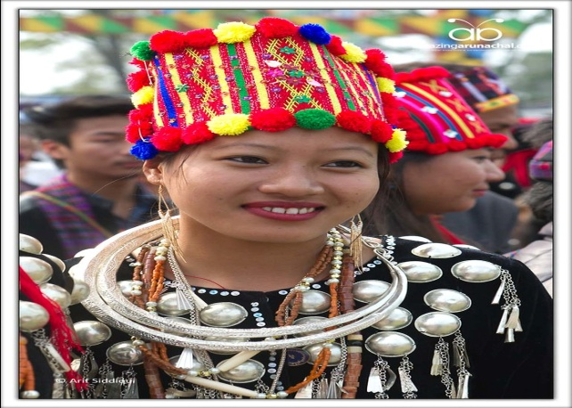



HEADGEARS OF DIFFERENT TRIBES

Slide 19






SELFHELP GROUPS ,OTHER GROUPS UNDER GOVT. SCHEMES AND NGOs

Slide 20

NREGA
NERCORMP
SABKI

Slide 21










CANE AND BAMBOO PRODUCTS

Slide 22









CARPET MASKS AND WOOD-BAMBOO CURVINGS

Slide 23




AGRICULTURAL WASTE TO HANDCRAFTS

Slide 24



Slide 25

TECHNICAL AND INDUSTRIAL INSTITUTES IN
ARUNACHAL PRADESH
5 ENGINEERING COLLEGES :
NIT ARUNACHAL PRADESH
NERIST
RGU
ARUNACHAL UNIVERSITY
HIMALAYA UNIVERSITY
POLYTECHICS OR
INDUSTRIAL TRAINING INSTITUTE : 11

Slide 26

AATMA NIRBHAR BHARAT :
“LOCAL KE LIYE VOCAL”
ARUNACHAL PRADESH ENTREPRENEURSHIP CHALLENGE

Slide 27



APICULTURE
PISCICULTURE
SERICULTURE

Slide 28







HORTICULTURAL PRODUCTS

Slide 29
JAI HIND
AND
THANK YOU

