Slide 1
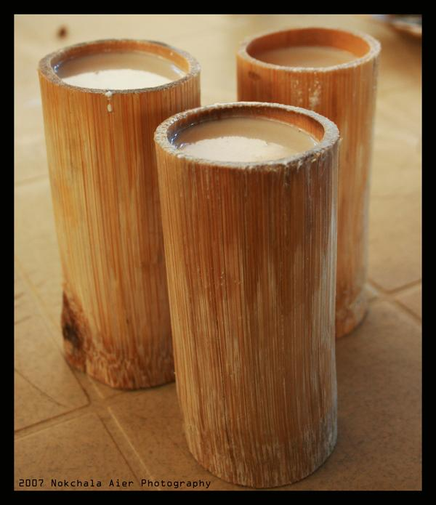
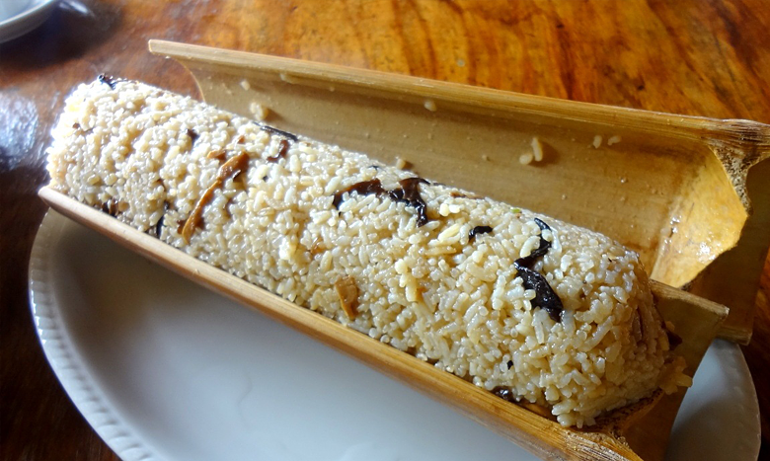
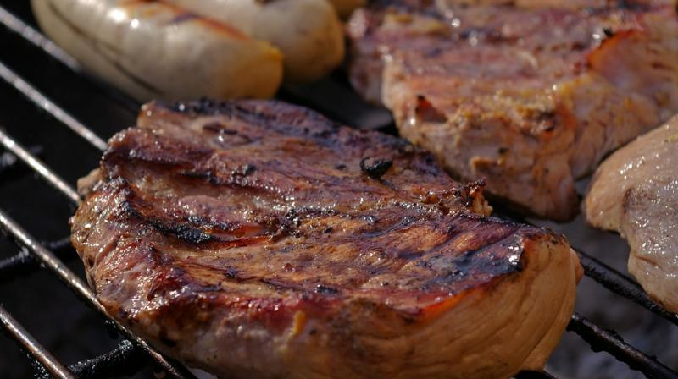
Appetizing Aroma of Arunachal Cuisine
Presented by:
Dr. Millo Yasung
Department of Management and Humanities
NIT, Arunachal Pradesh

Slide 2

Dong Valley, Anjaw District

Slide 3
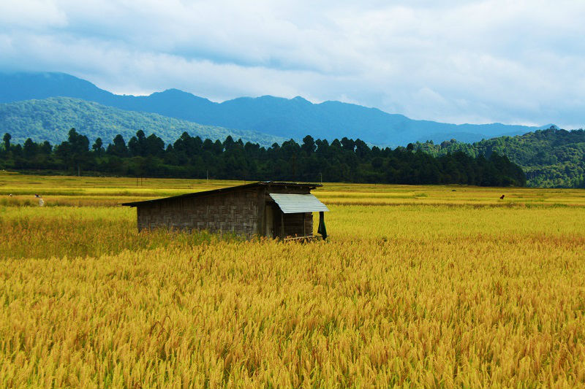
Ziro, Lower Subansiri

Slide 4
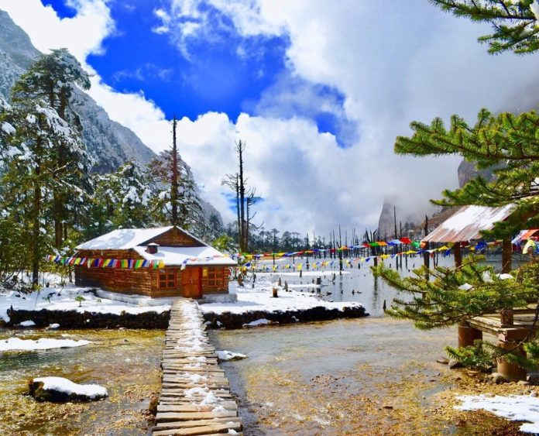
Tawang

Slide 5
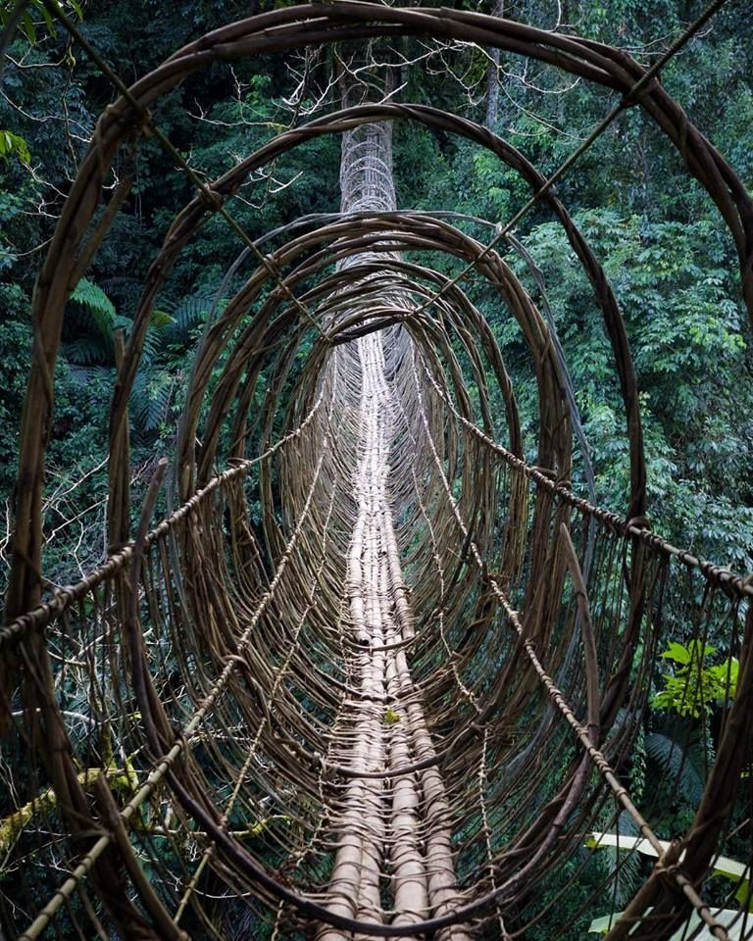
Hanging Bridge, Boleng

Slide 6
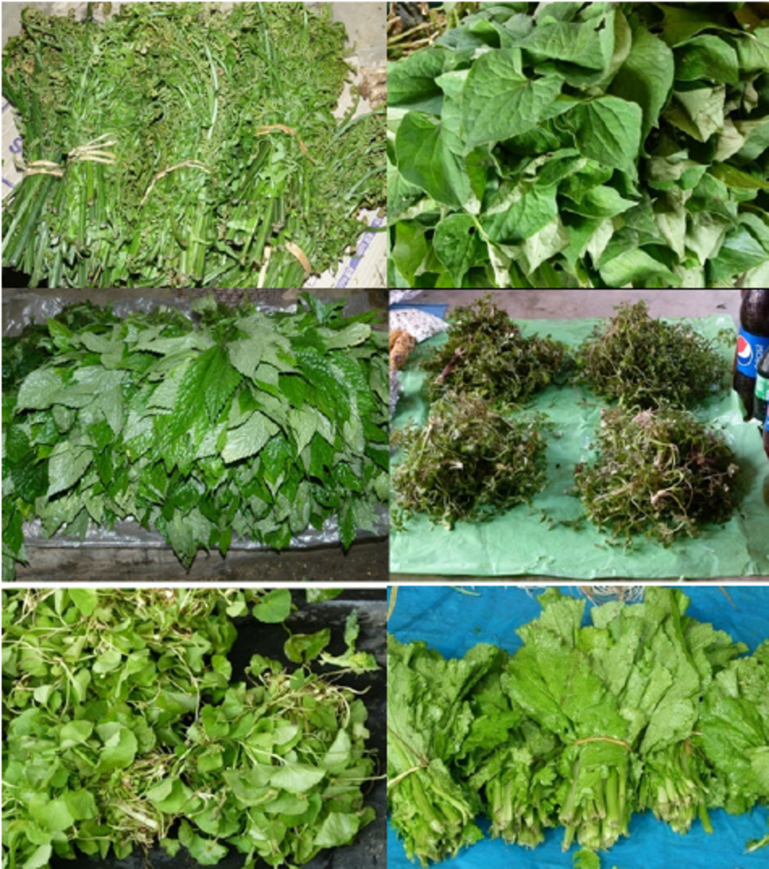
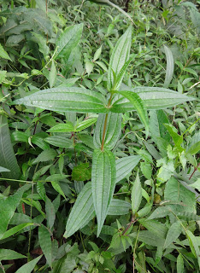
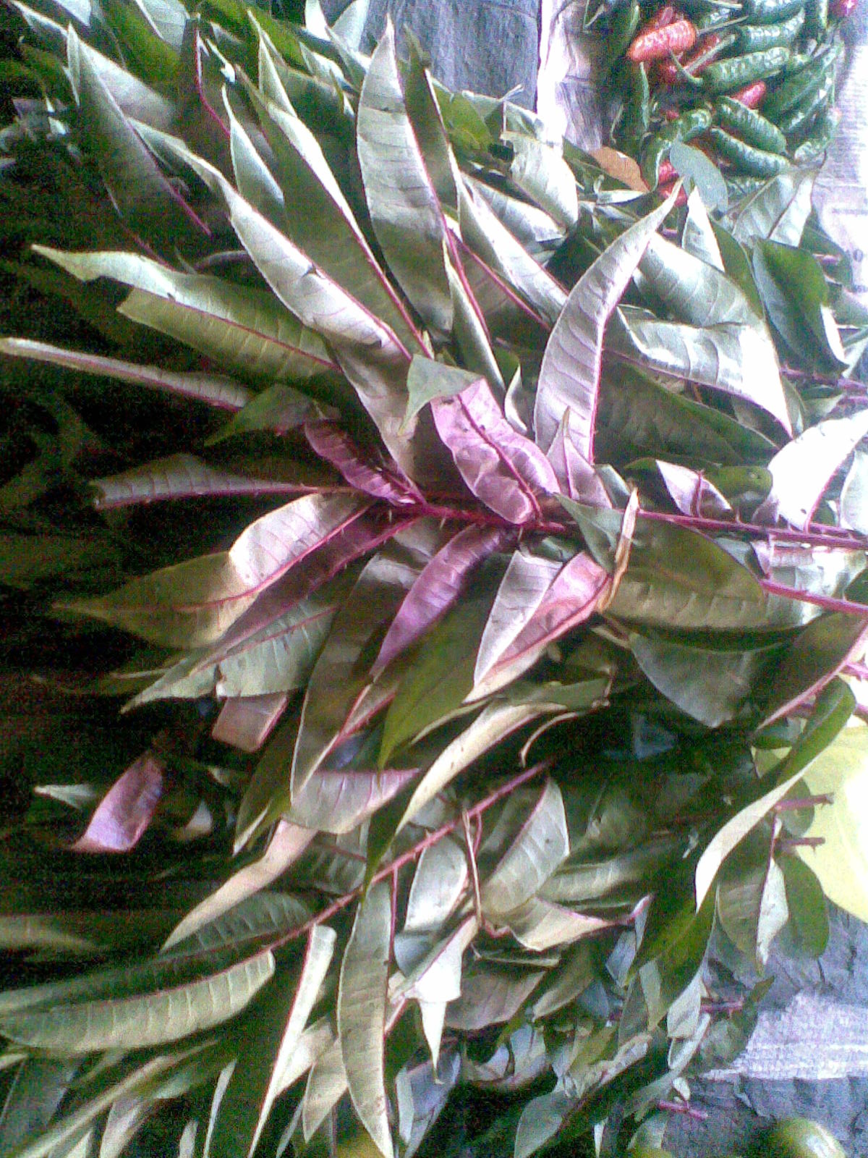
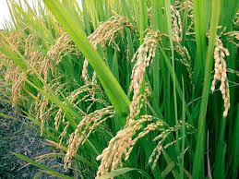
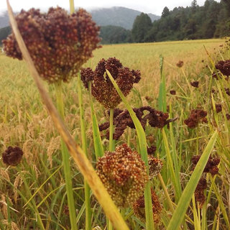
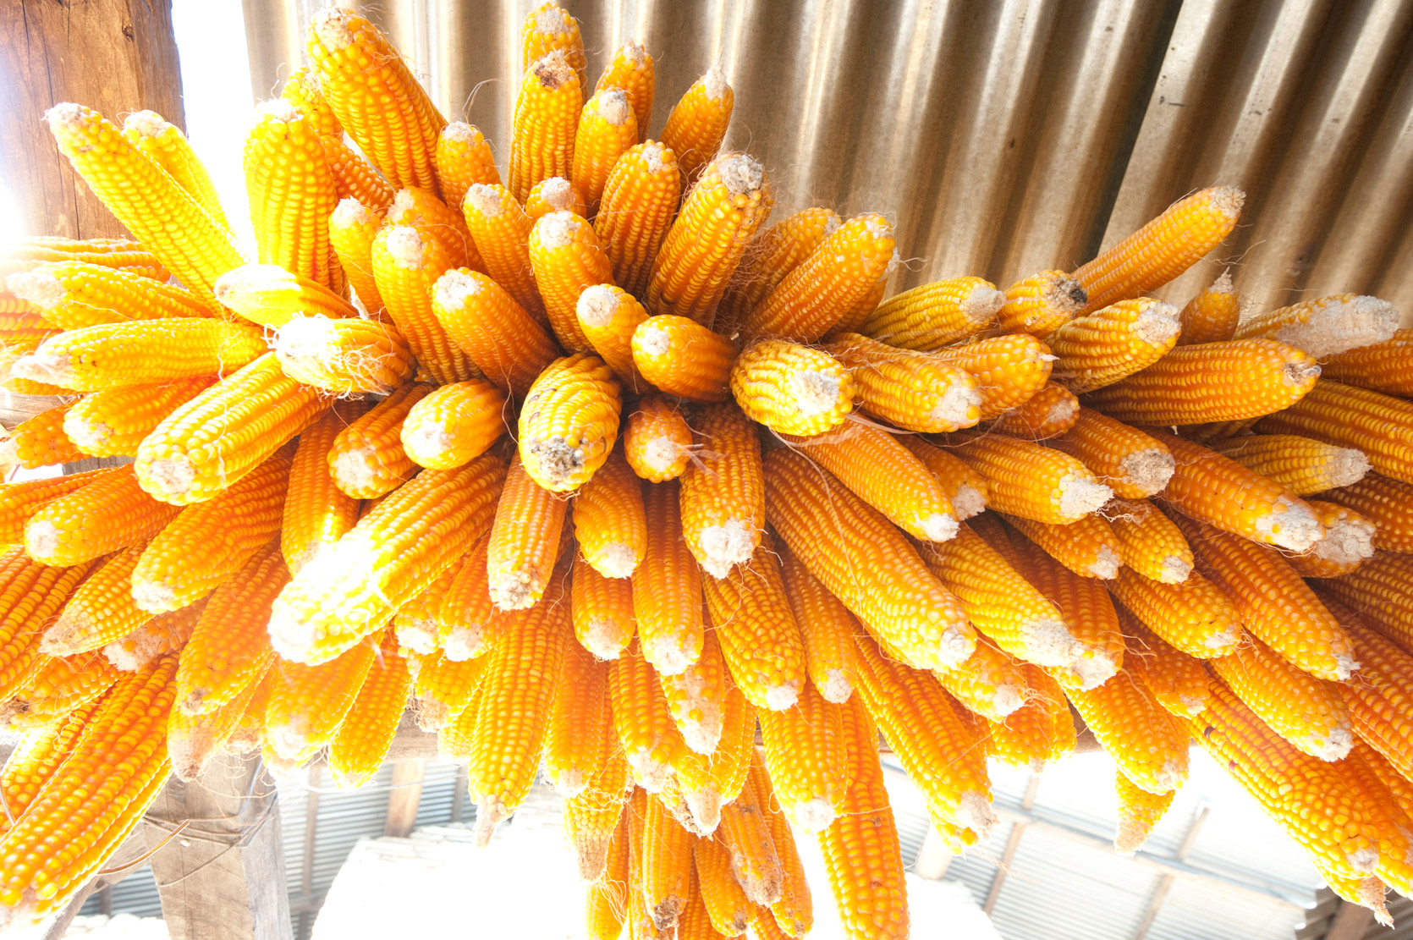
Farm Produce and
Wild herbs

Slide 7
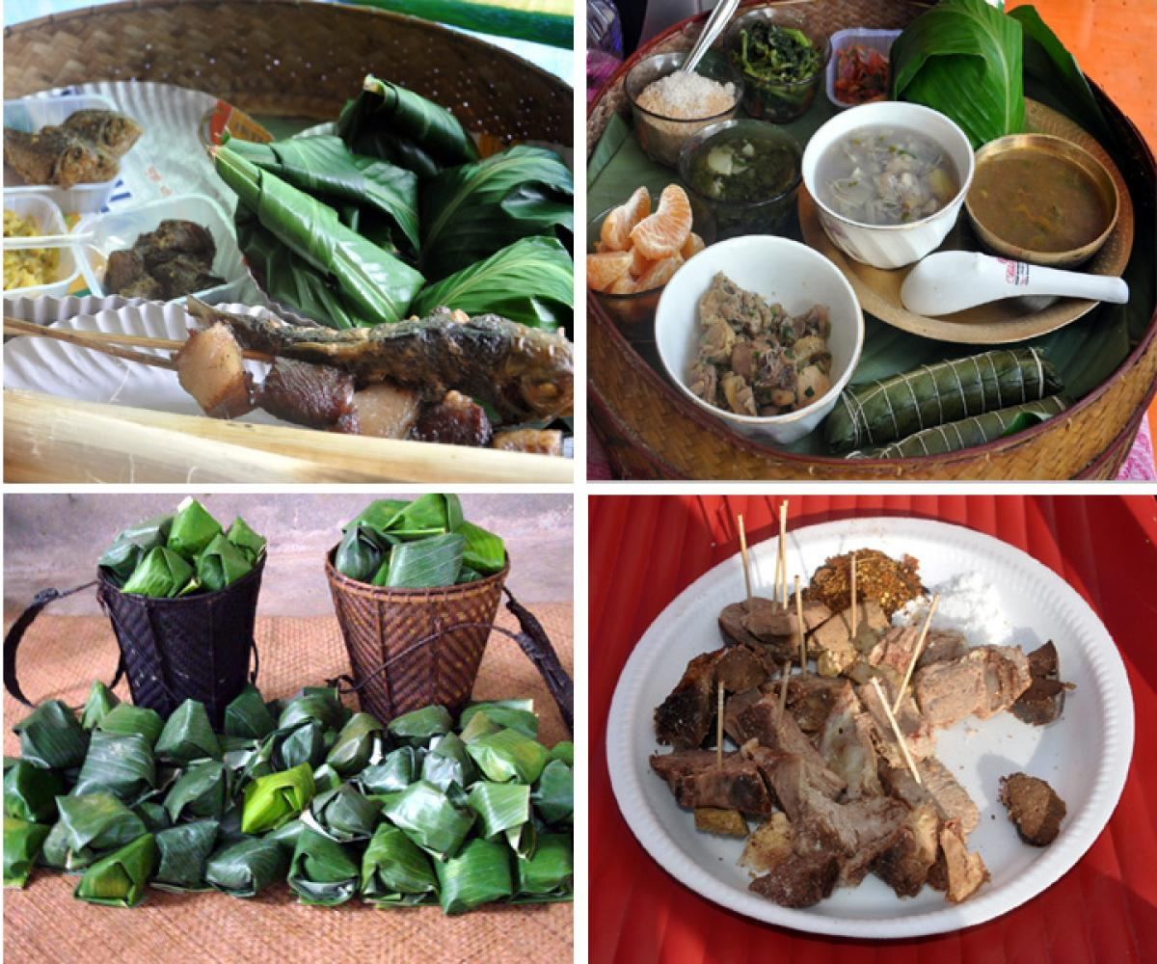
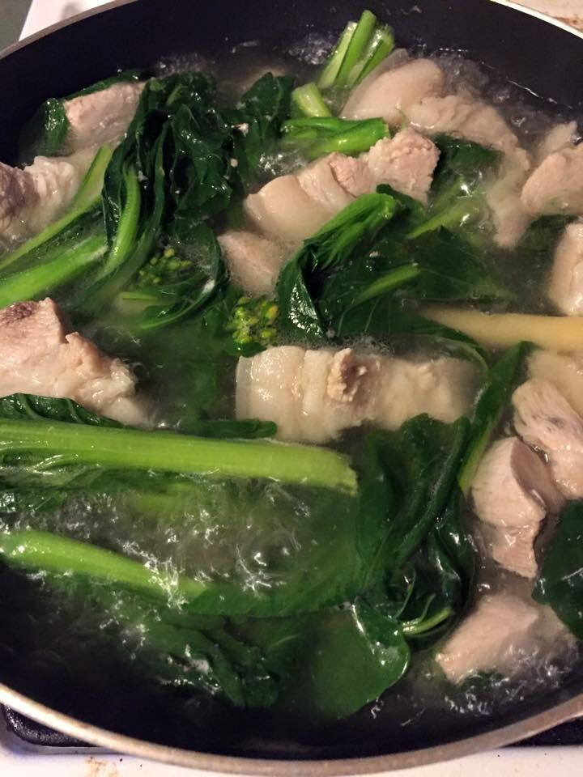
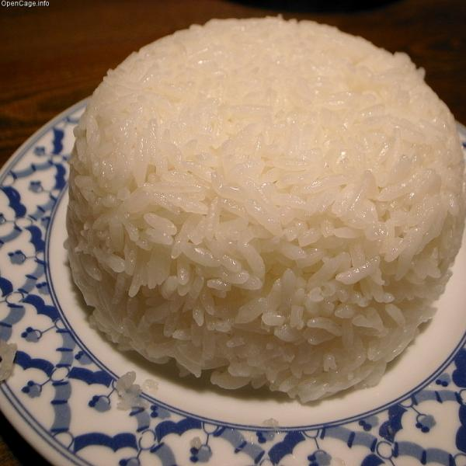
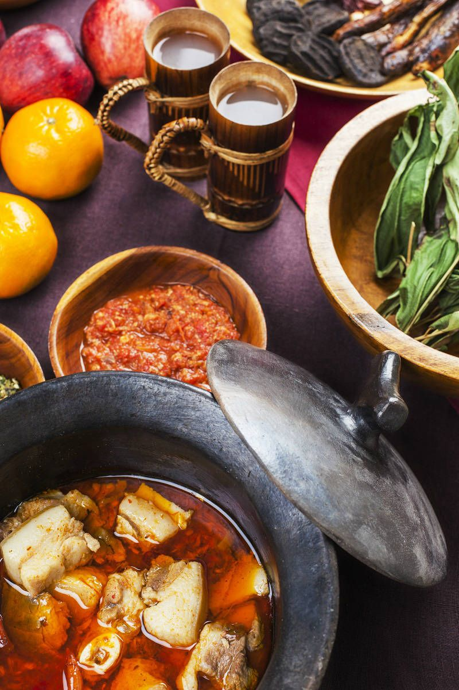
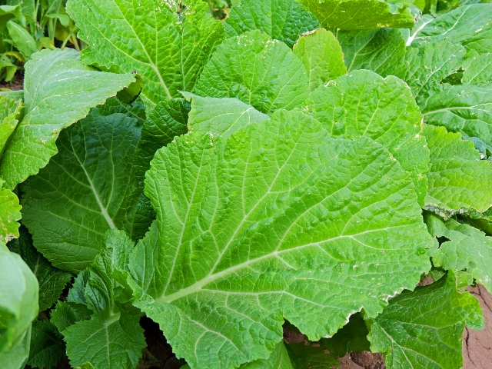
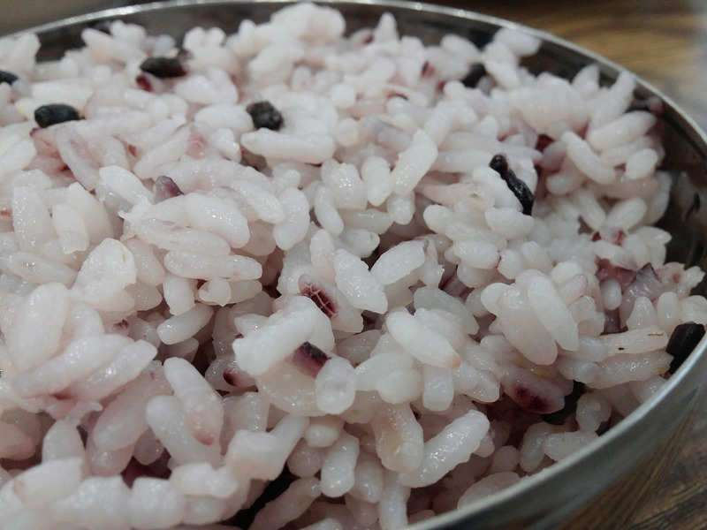
Staple Food

Slide 8
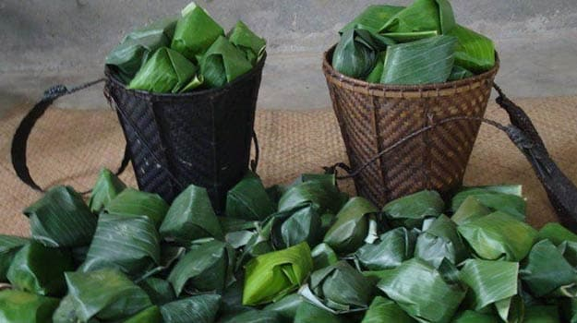
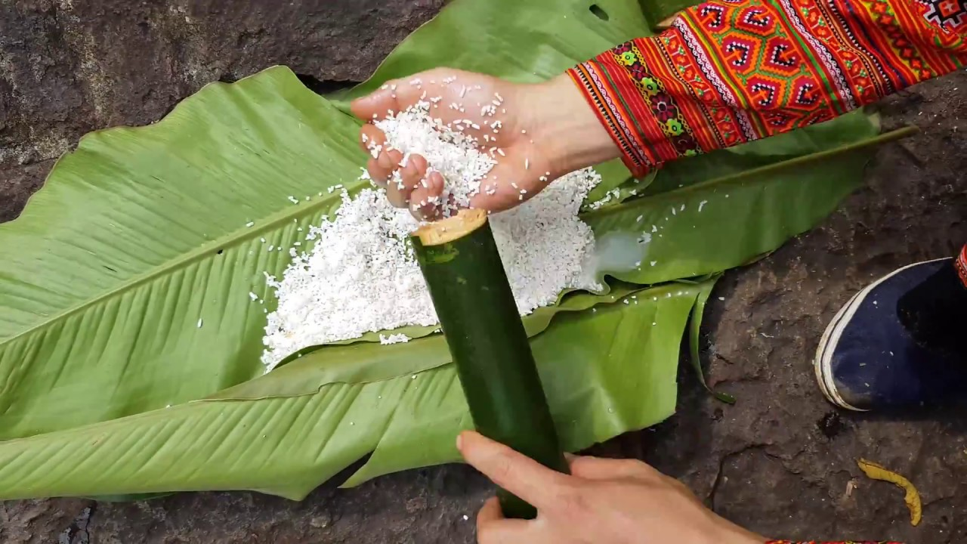
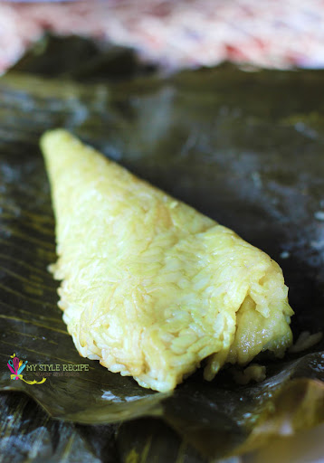
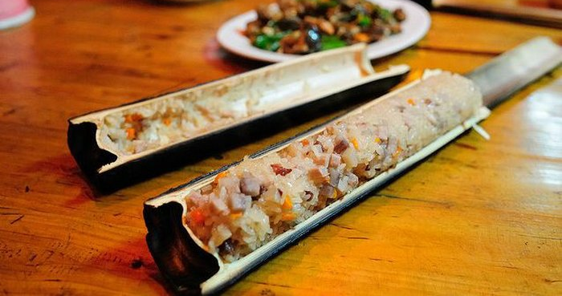
All About Rice
Dung Po
Khaolam

Slide 9

Rice in a bamboo

Slide 10
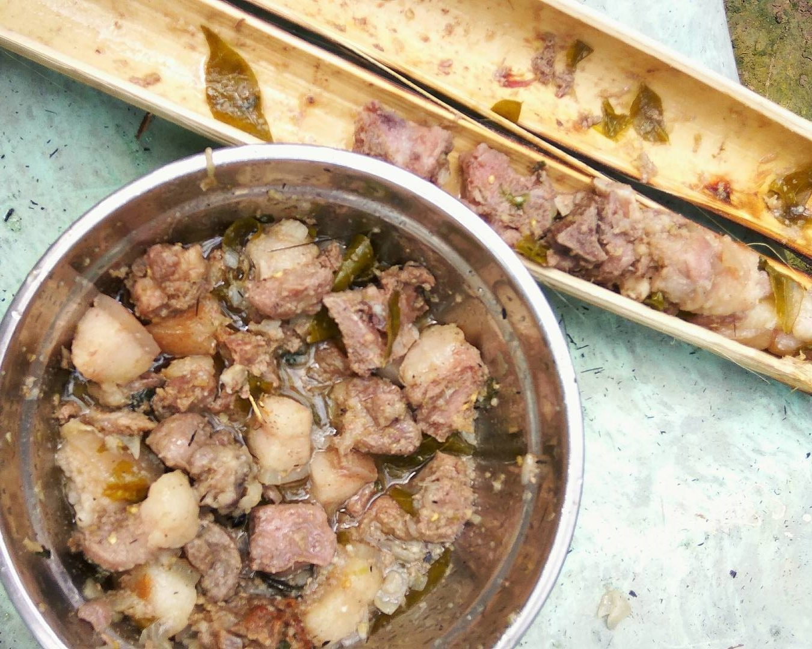
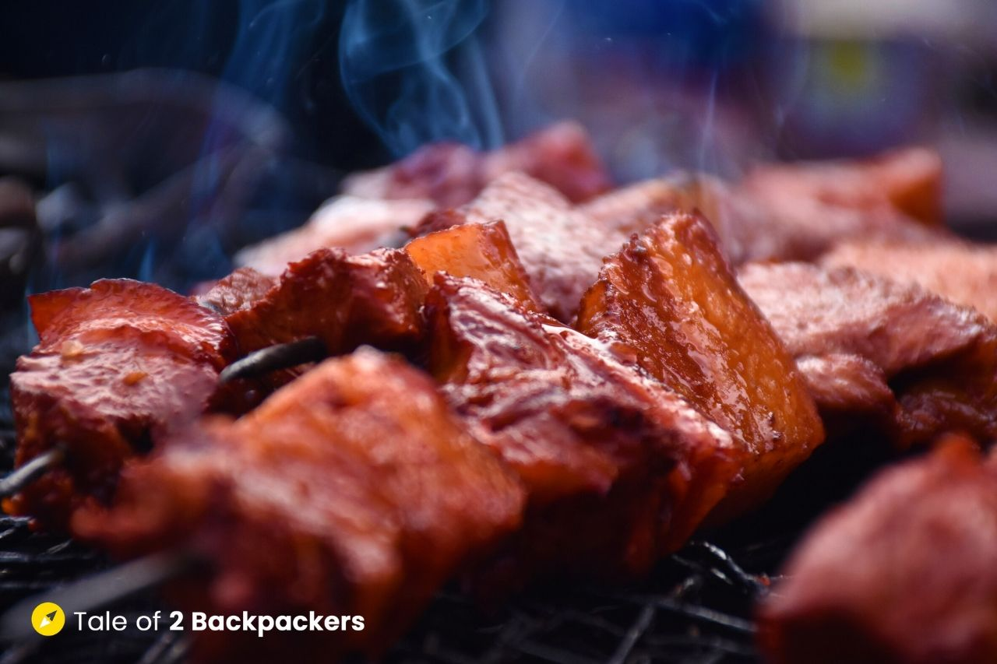
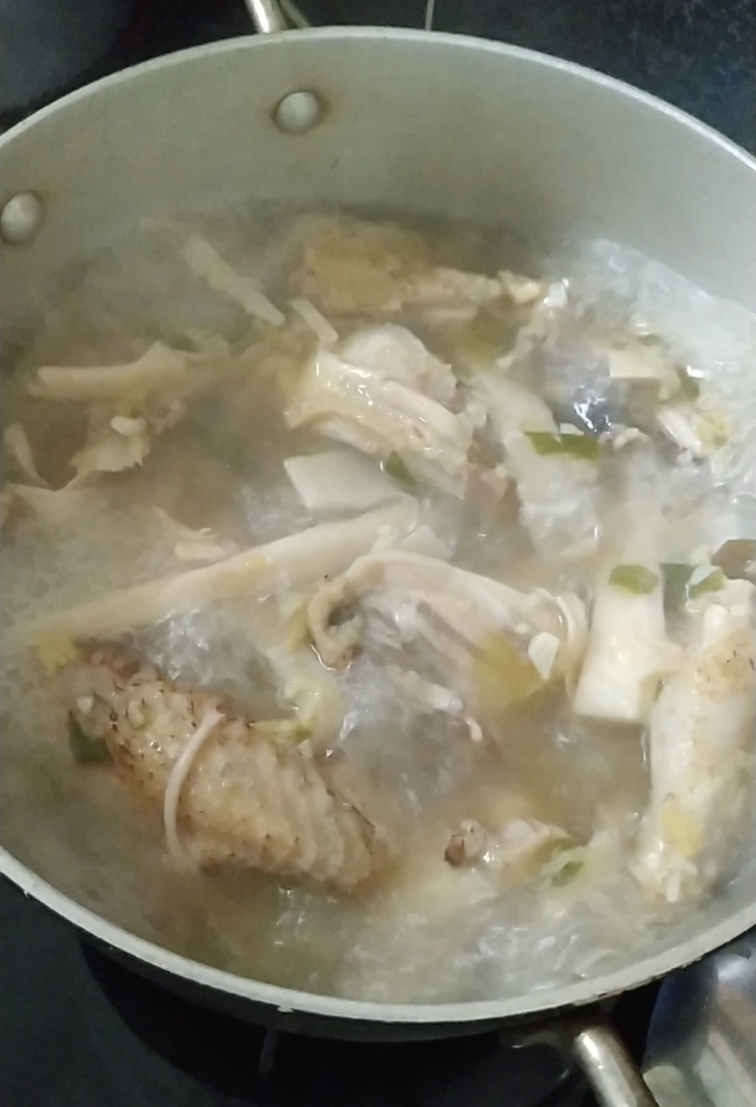
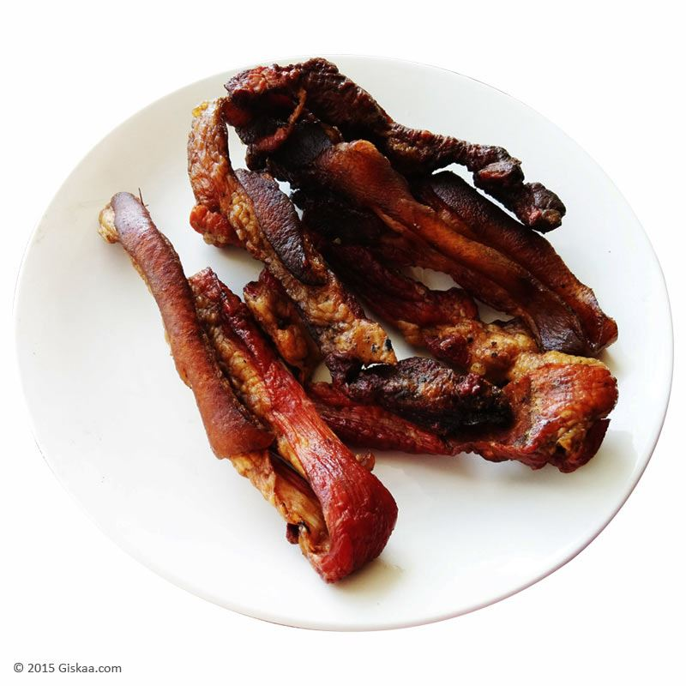
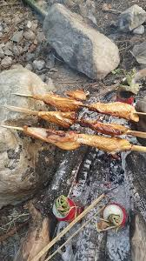
Meat Lovers

Slide 11
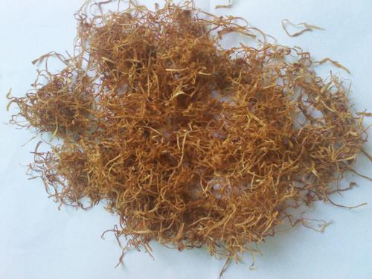
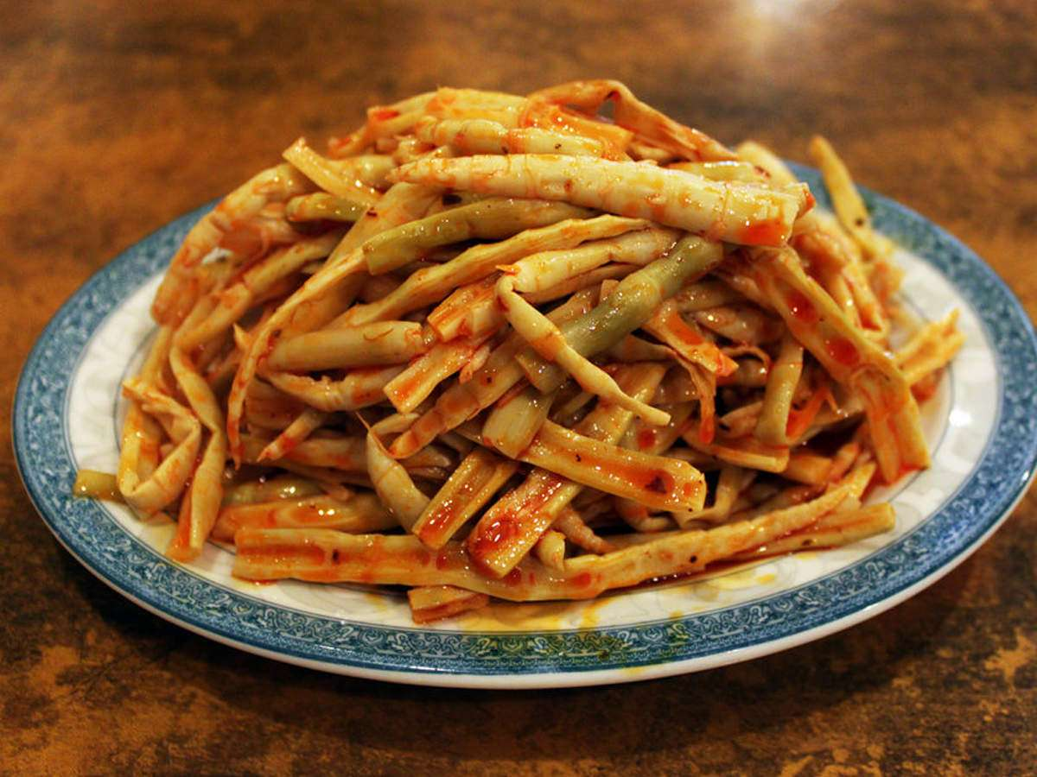
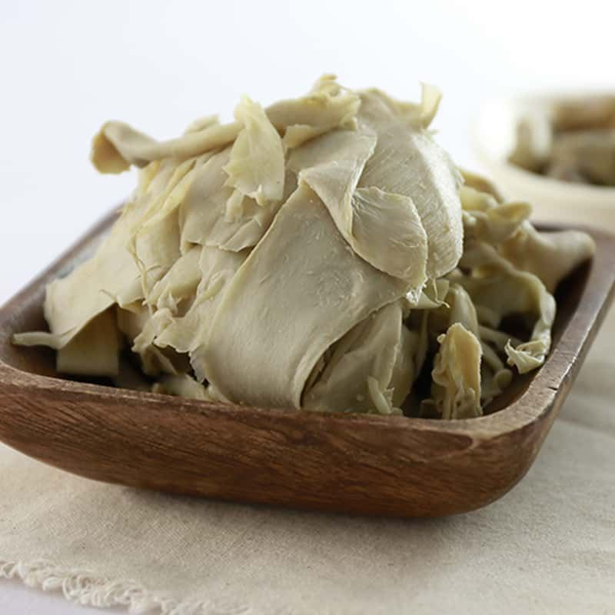
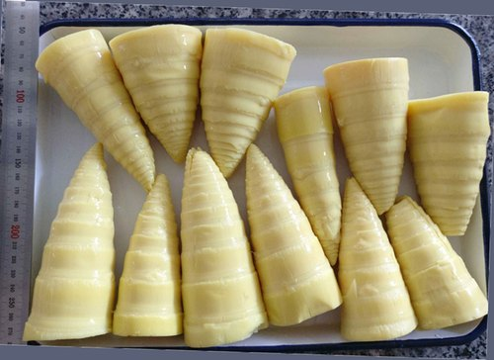
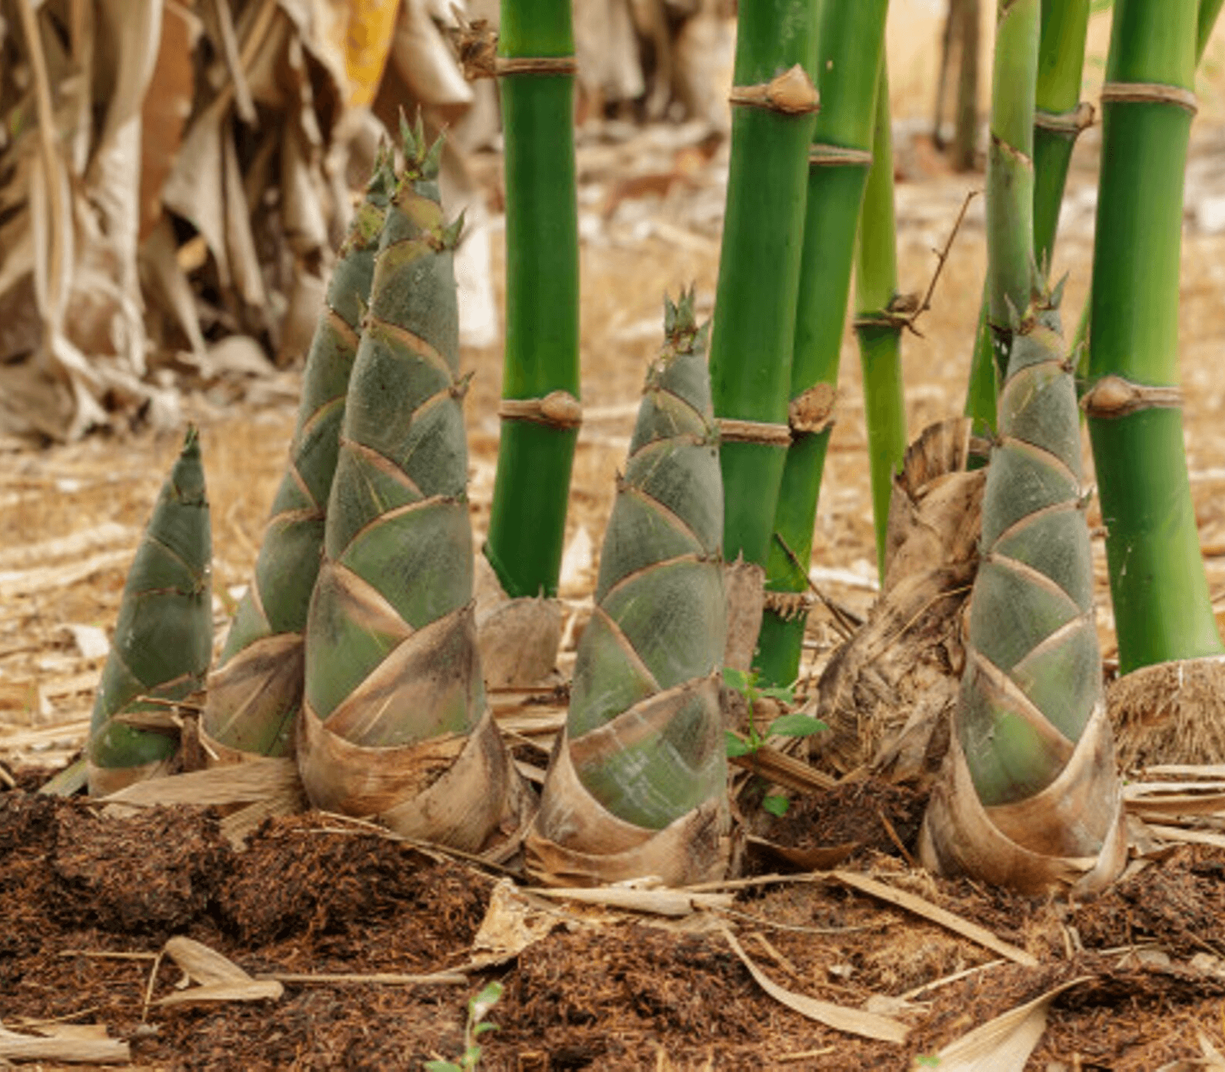
Bamboo Shoot
Dry Bamboo Shoot Bamboo Shoot Dish
Fermented Bamboo Shoot
Fresh Bamboo Shoot Bamboo Plant

Slide 12
Chicken Boil with Bamboo Shoot

Slide 13
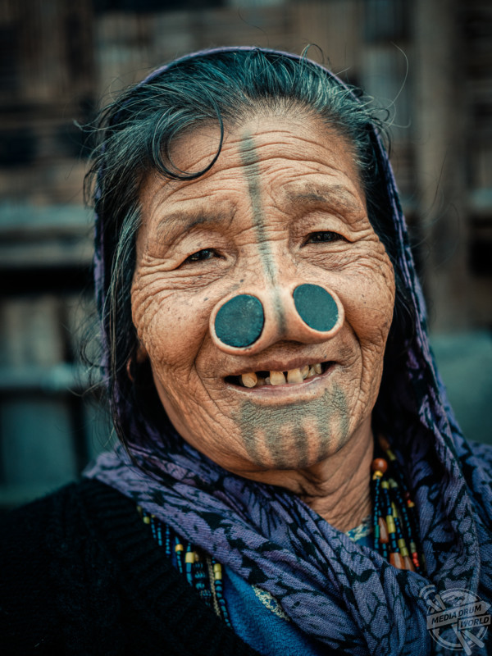
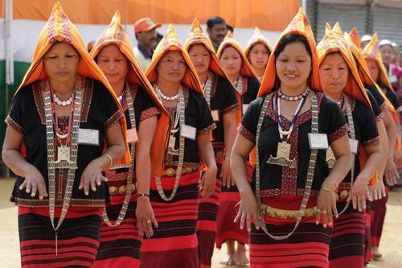
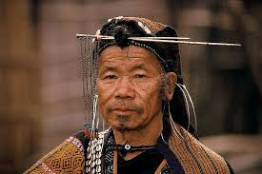
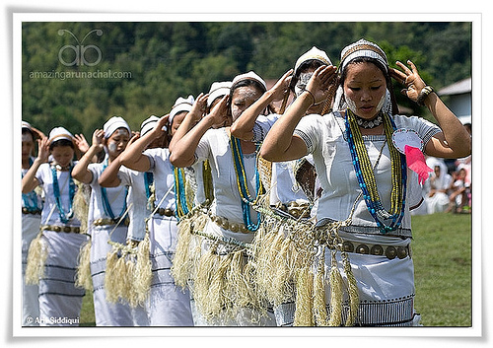
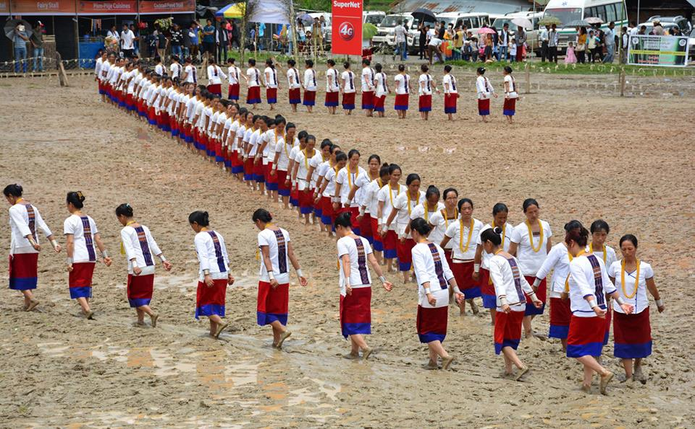
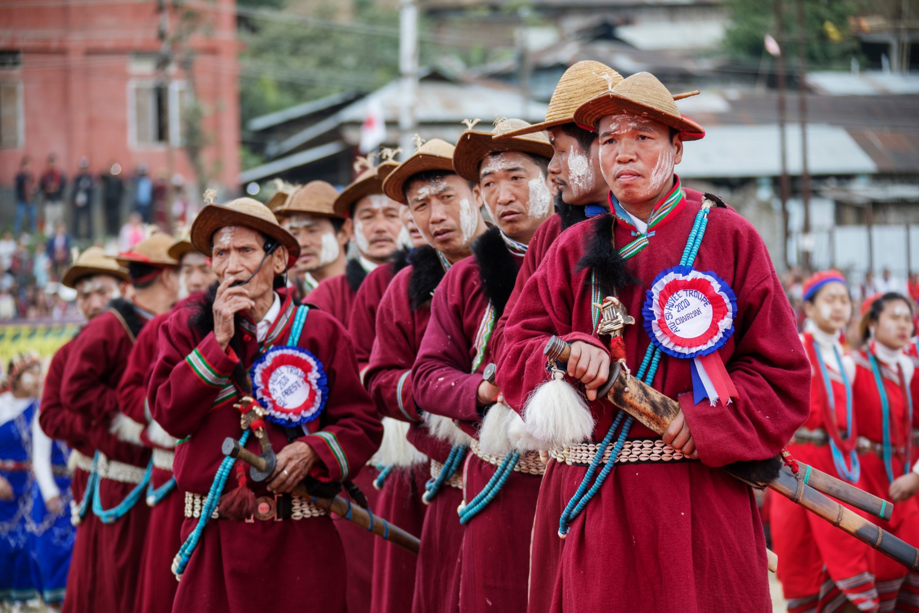
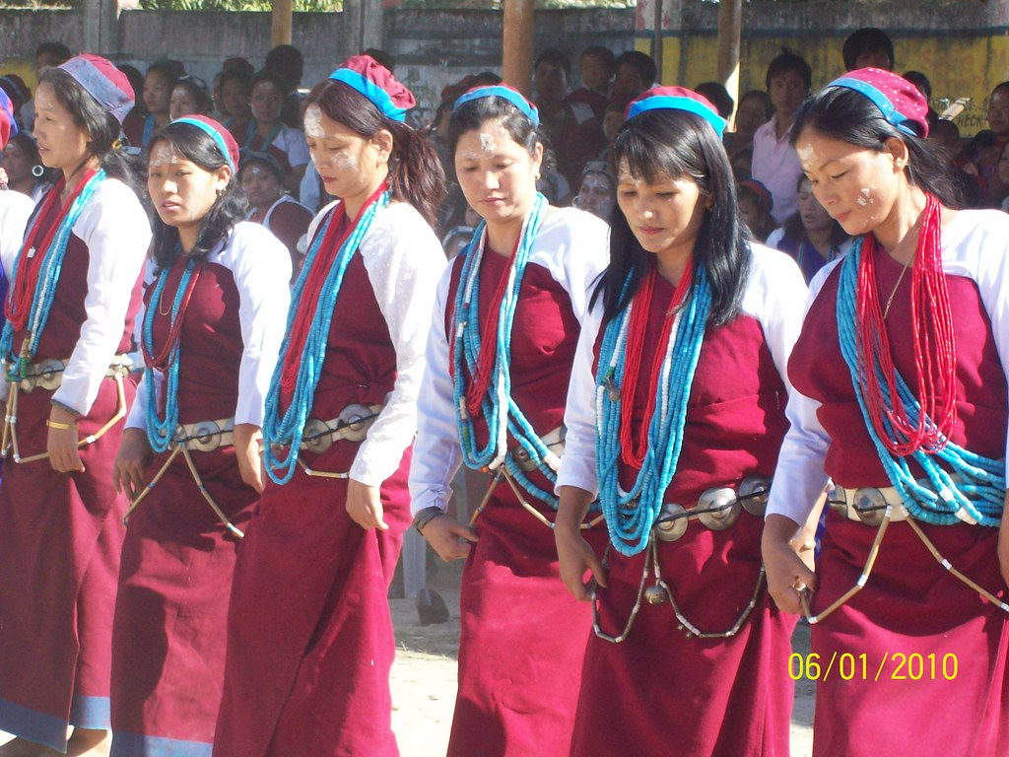
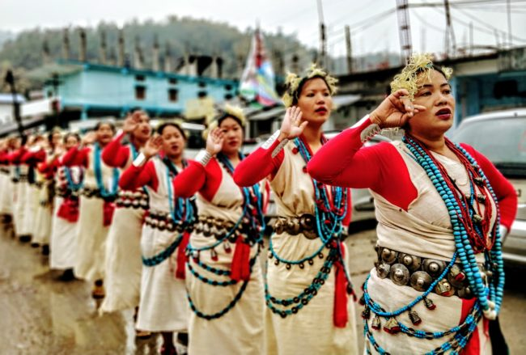

Slide 14
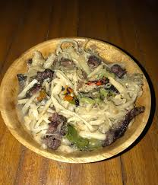
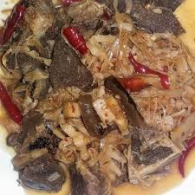
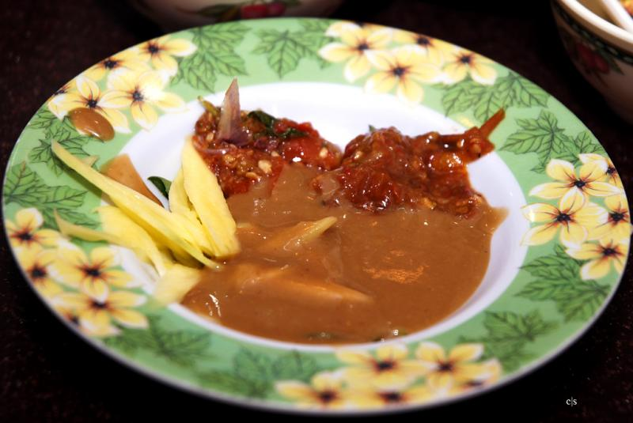
Pikey Pilla

Slide 15
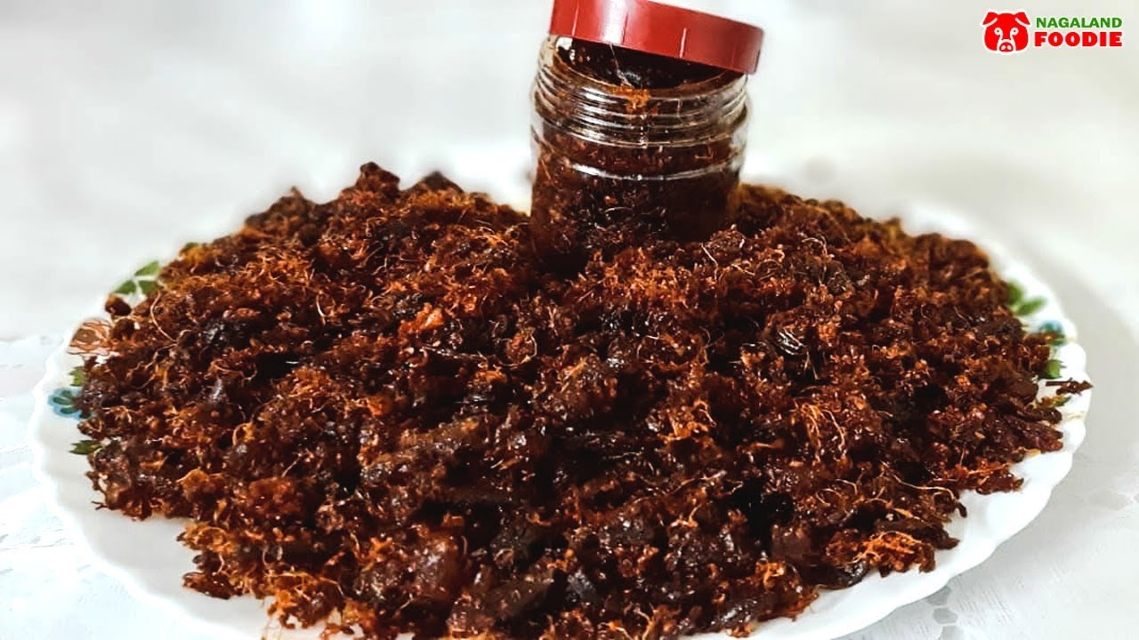
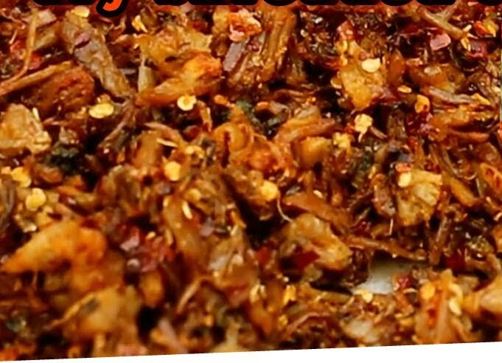
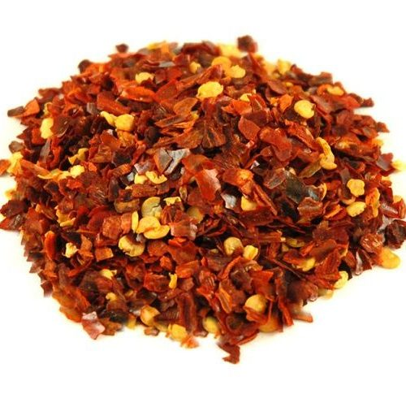
Lukter/Yormi
Ingredients
Chicken : 250 grams
Dried chilies : 250 grams
Salt as per taste
Oil to fry the chicken
Method
Roast the dried chilies in a pan.
Grind the roasted chilies.
Boil chicken till it cooks properly and drain the water.
Shred the chicken and keep it for drying.
Take a pan and fry the chicken once it is dry.
Mix the chily flakes and shredded fried chicken together.
Add salt as per taste.

Slide 16
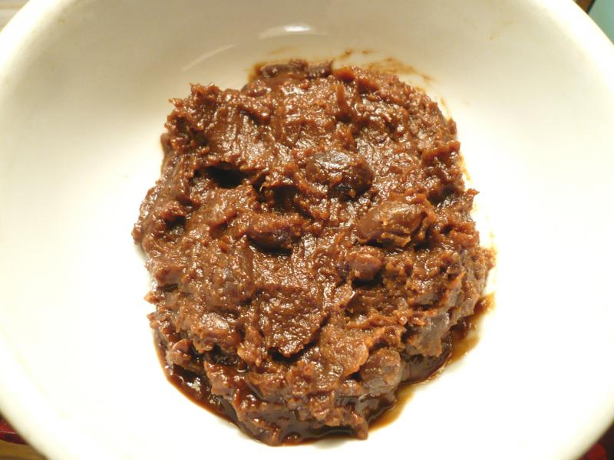
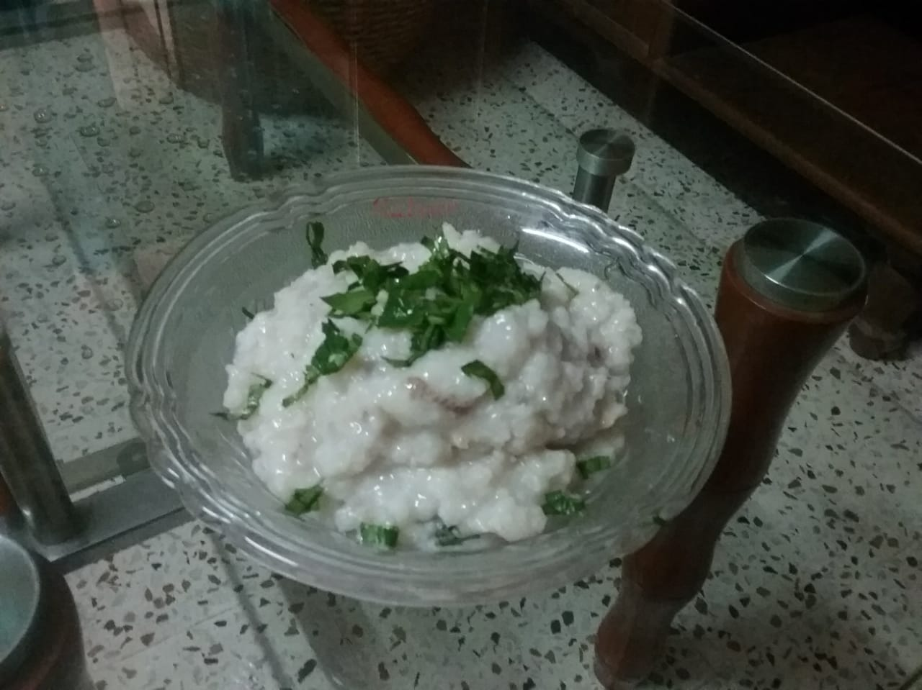
Pehak
Aamin

Slide 17
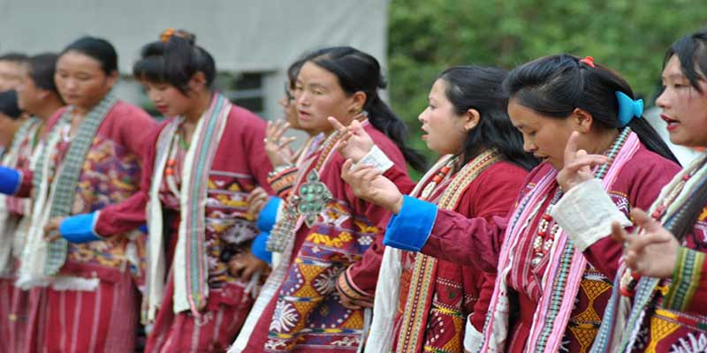
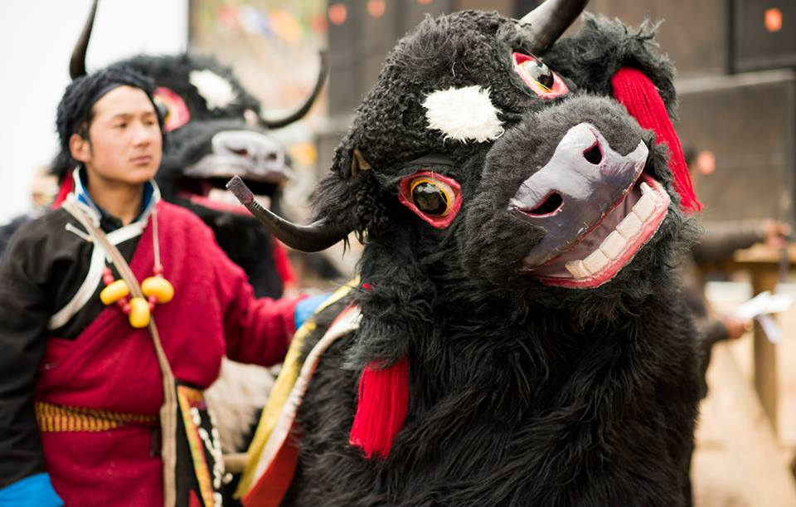



Slide 18


Po Cha (Butter Tea)
First step, prepare black tea. Then, add salt. Add milk to the black tea. Boil for a while and add butter. Heat till it’s creamy. Serve it as tea or soup.
Khura

Slide 19

Chura Sabji

Slide 20


Thukpa
Momos

Slide 21


Khapse

Slide 22






Slide 23



Ngatok
Pasha

Slide 24


Wungwut Ngam

Slide 25



Beverage (Apong/Opo/O)

Slide 26
Rice Beer Preparation

Slide 27
Thank You for your Patience

