Slide 1
Life STYLE OF ARUNACHAL PRADESH
Kashish Singh
II Year B.Tech
EE
NIT-AP

Slide 2
ARUNACHAL PRADESH AT A GLANCE
Arunachal Pradesh literally “land of dawn-lit mountains” is the northeastern state of India. It borders the states of Assam and Nagaland to the south.
It shares international borders with Bhutan in the west, Myanmar in the east, and border with China in the north at the McMahon Line.
Itanagar is the state capital of Arunachal Pradesh. Arunachal Pradesh is the largest of the Seven Sister States of Northeast India by area.
As of the 2011 Census of India, Arunachal Pradesh has a population of 1,382,611 and an area of 83,743 square kilometres (32,333 sq mi). It is an ethnically diverse state, with predominantly Monpa people in the west, Tani people in the center, Tai people in the east, and Naga people in the south of state.

Slide 3
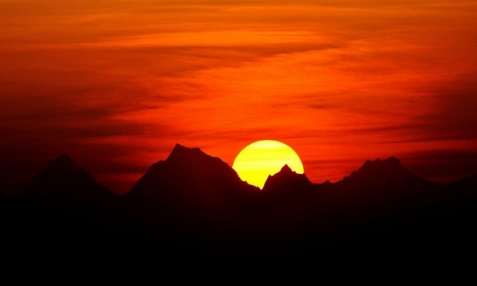
Rising Sun
When the sun first strikes India, it shines upon Arunachal’s wild jungles and tribal communities. Arunachal, means “land of rising sun”. Arunachal Pradesh is a sprawling mountainous territory, a land of mighty rocks and luxuriant forests, gentle streams and ragging torrents, presents a breath-taking spectacle of nature in all her glory, raw and unspoilt and untamed in wild profusion of flora and fauna, customs, language and dress.

Slide 4
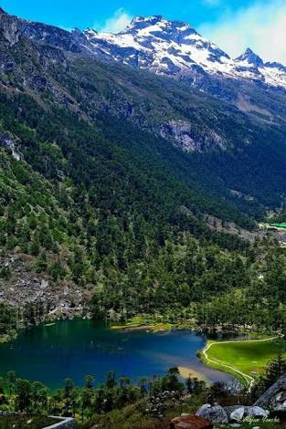
Mountains & Vallys
It is a land of lush green forests, deep river valleys and beautiful plateaus. The land is mostly mountainous with Himalayan ranges along the northern borders criss-crossed with mountain ranges running north-south. These divide the state into five river valleys: the Kameng, the Subansiri, the Siang, the Lohit and the Tirap. All these rivers are fed by snows from the Himalayas and countless rivers and rivulets except Tirap which is fed by Patkai Range.The mightiest of these river is Siang, called Tsangpo in Tibet, which becomes Brahmaputra after it is joined by the Dibang and the Lohit in the plains of Assam.
High mountains and dense forests have prevented intercommunication between tribes living in different river valleys. The geographical isolation thus imposed has led different tribes to evolve their own dialects and grow with their distinct identities. Nature has endowed the Arunachal people with a deep sense of beauty which finds delightful expression in their songs, dances and crafts.

Slide 5
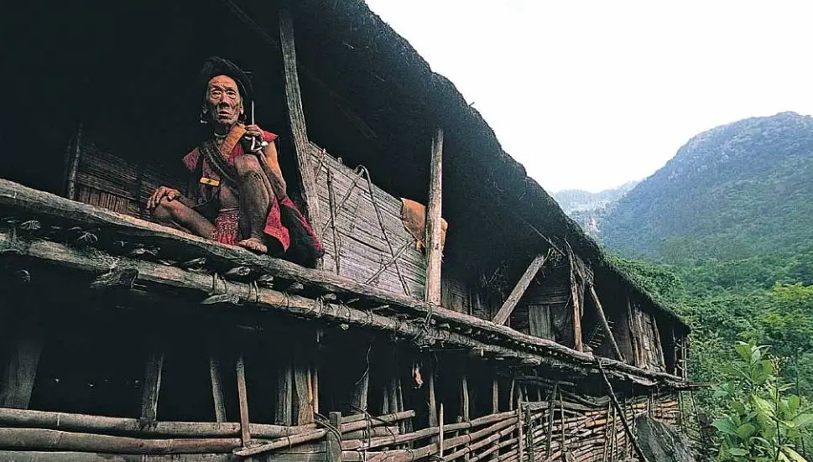
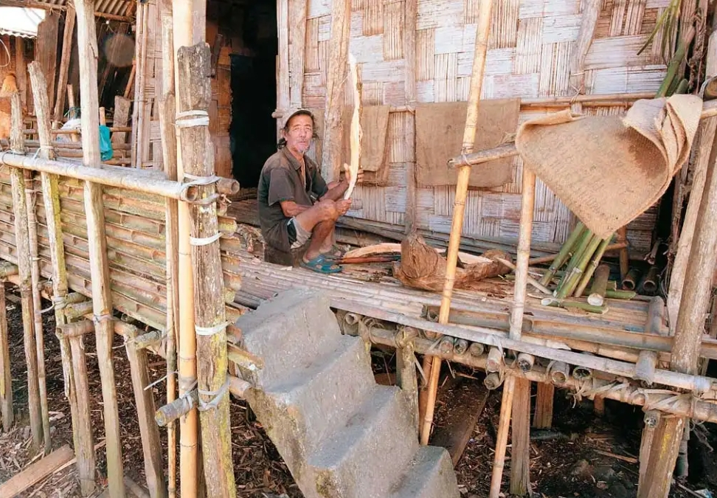
Tribal
The origins of the tribes that are currently living in Arunachal Pradesh remain shrouded in mystery. It is widely believed that the tribes who inhabit this land now, came from Burma (present day Myanmar) and Tibet, where Mongoloid tribal groups with similar cultures still live.
Over the course of these migrations, several inter-tribal feuds occurred, which resulted in the groups scattering across the region.
Every tribe knows its territories and the rivers that come under them and which particular clan alone has hunting or fishing rights over that area. In order to maintain a distinct identity, each tribe used tattoos, headgears or nose plugs.

Slide 6
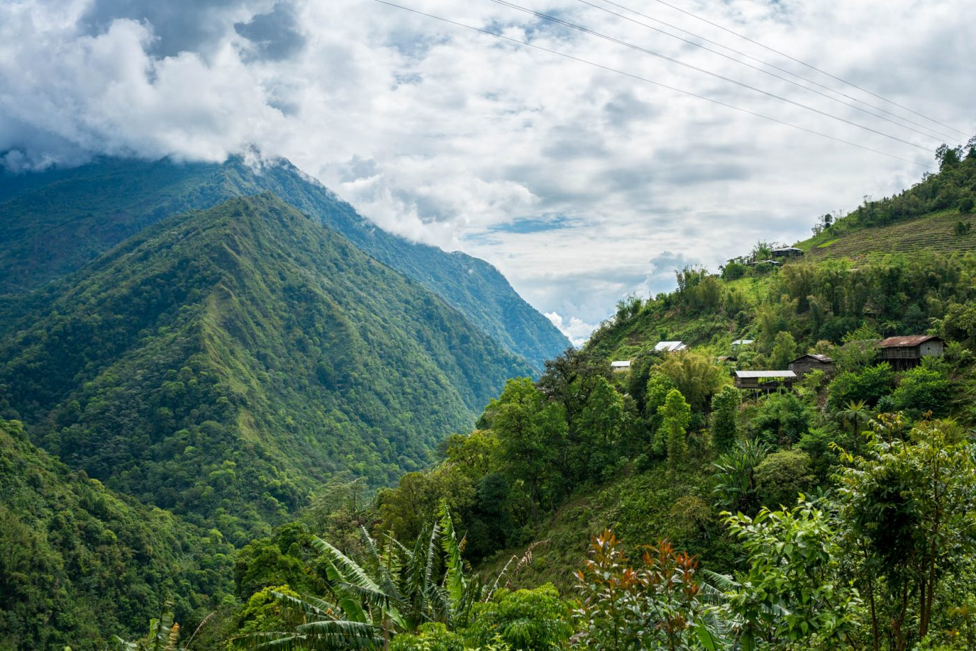
Districts of Arunachal Pradesh

Slide 7
ANJAW
CHANGLANG
DIBANG VALLEY
EAST KAMENG
EAST SIANG
ITANAGAR
KRA DAADI
KURUNG KUMEY
LOHIT
LONGDING
LOWER BIGANG VALLEY
LOWER SUBANSIRI
NAMSI
PAKKE-KESSANG
PAPUMPARE
SIANG
TAWANG
TIRAP
UPPER SIANG
UPPER SUBANSIRI
WEST KAMENG
WEST SIANG

Slide 8
AGRICULTURE
According to 2001 Census, population is 482206 (male-293549 and female-188657).
The number of cultivators is 281822 and that of agricultural labourers is 18569.
About 80% of population living in rural area is dependent on agriculture 62.29% of total working populations are engaged in agriculture.
Agriculture plays the most important role in the economic development in the State.

Slide 9
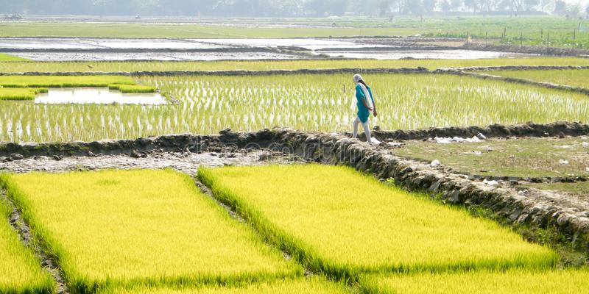
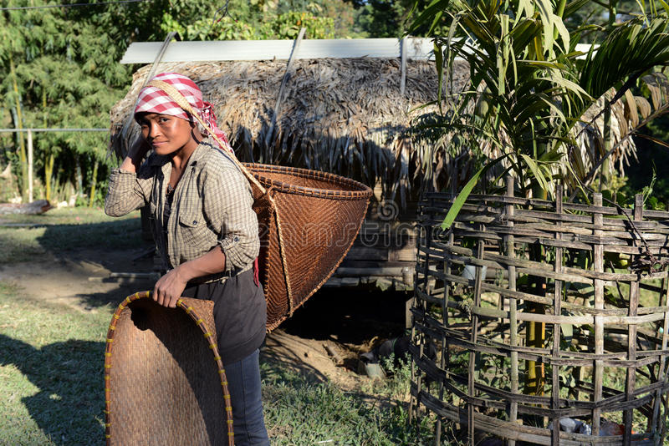
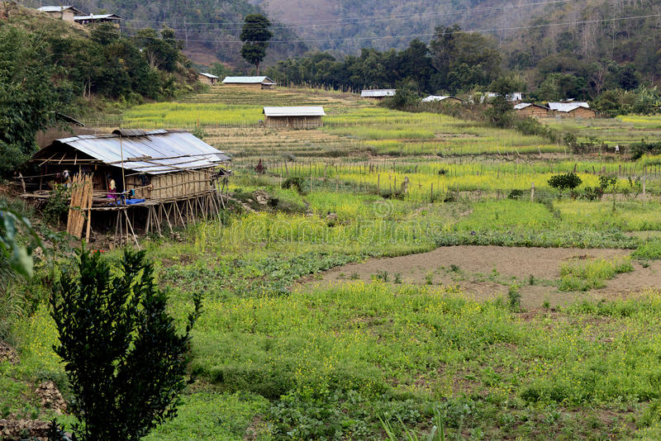
Jhum cultivation and terrace farming are two major forms of farming practices commonly used by the farmers in Arunachal Pradesh. ... The topography and agro-climatic of the state are virtuous for the cultivation of Rice, Millet, Wheat, Pulses, Sugar cane and Potatoes.

Slide 10
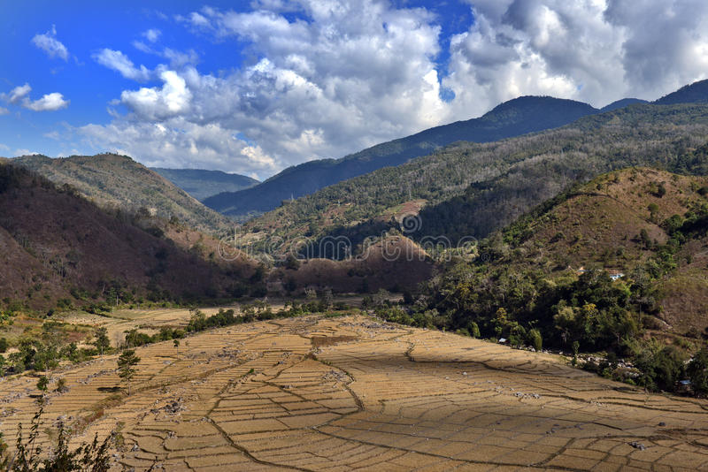
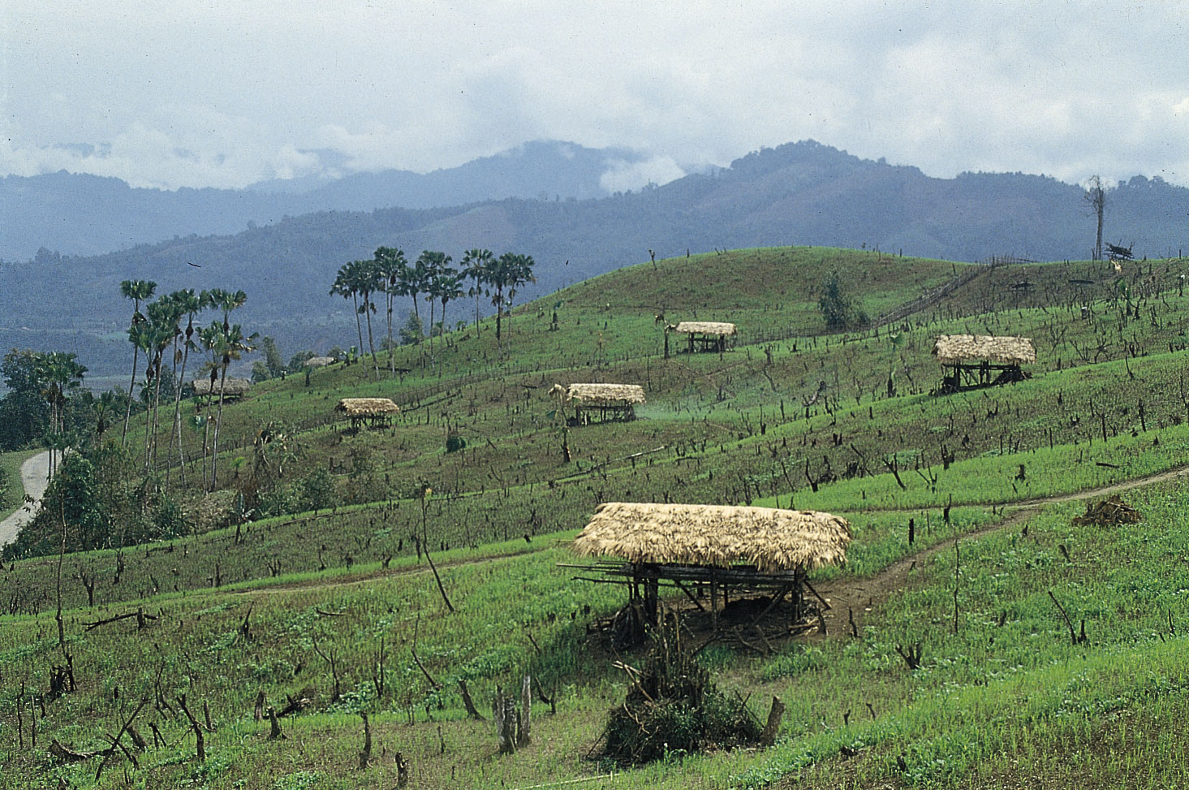
Agricultural Fields

Slide 11
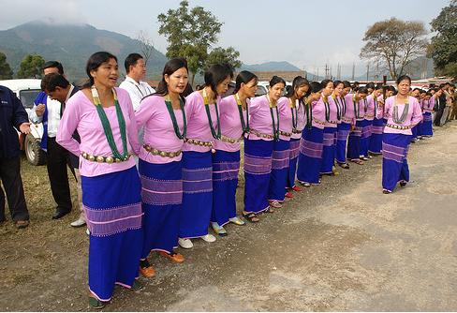
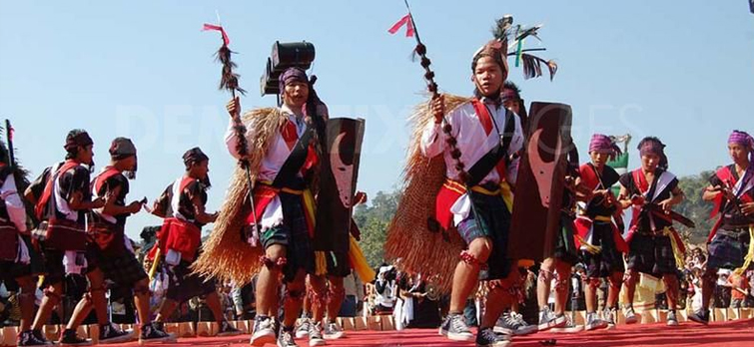
Celebrations in Arunachal Pradesh
Pangsau Pass Winter Festival
Siang River Festival

Slide 12
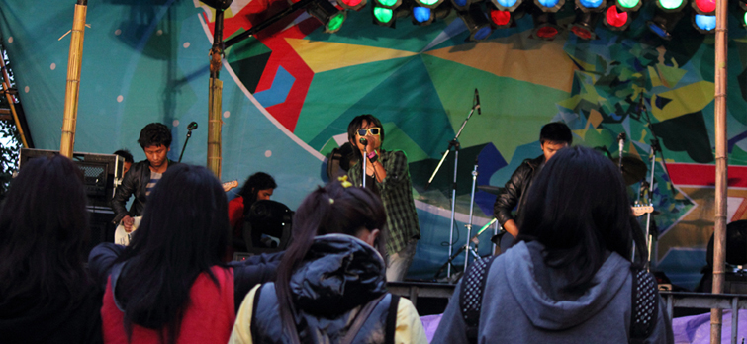
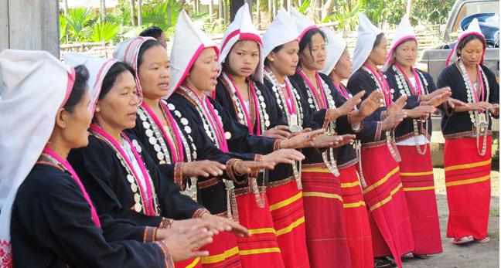
Solung
Ziro Festival of Music

Slide 13
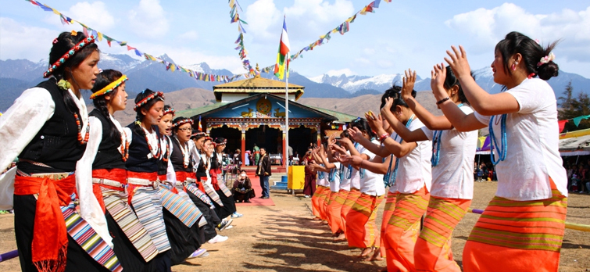
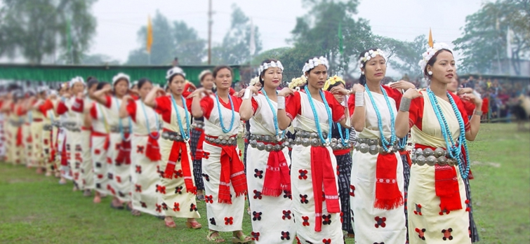
Nyokum
Losar Festival

Slide 14
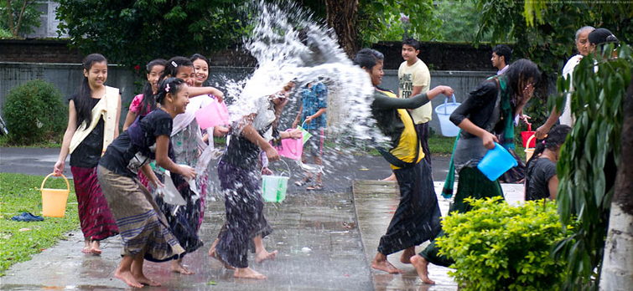
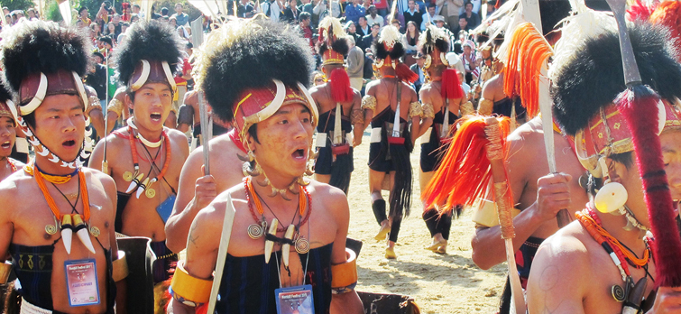
Sanken
Loku

Slide 15
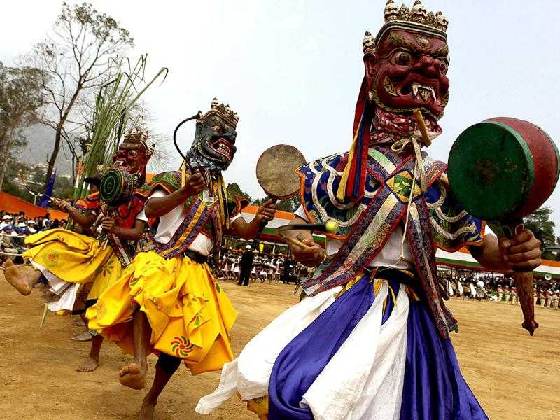
Dance in Arunachal Pradesh
Dance and music are an essential part of the life of Arunachali tribes. They dance and sing on important occasions and during the time of festivities and weddings. Various dance forms are seen in different parts of Arunachal. From elaborate religious dance dramas of the Buddhists to the martial arts and colourful dance performances of the Noctes and Wanchos, dance forms of Arunachal come in various formats. They can broadly be divided into four categories- Festive Dances, Ritual Dances, Recreational Dances and Dance Dramas.
Some popular folk dances in Arunachal Pradesh are Aji Lamu, Chalo, Hiirii Khaniing, Popir, Ponung, Pasi Kongki, Rekham Pada, Roppi, Lion and Peacock dance. Most of the dance forms are accompanied by chorus songs.

Slide 16
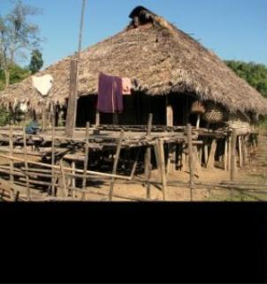
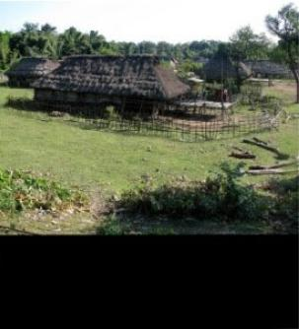
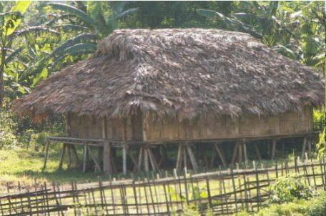
Houses of AP
The houses of the tribes of Arunachal Pradesh represent the traditional style of constructing the dwellings from the locally available materials and the size of the houses depends on the family patterns of the tribes. Since the living conditions are very tough in this area, the houses of the tribes are constructed to meet the challenge of nature.
With some local variations of design and style, the household articles of a normal tribes usually consist of brass or aluminum utensils for cooking, various types of containers made of cane or bamboo used for storing various items, mats, baskets for different uses, head gear etc.

Slide 17
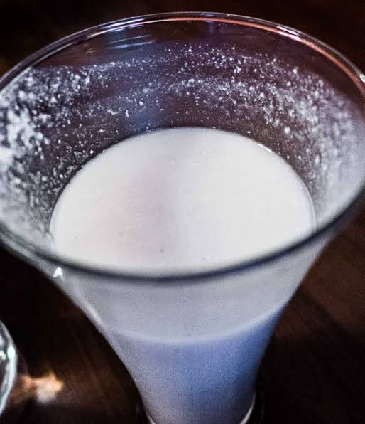
Origin Drink of Arunachal Pradesh
Apo or apung is an alcohol drink popular among the tribes in the North East Indian states of Arunachal Pradesh. It is prepared by fermentation of rice. It is generally served in a bamboo mugs.

Slide 18
WOMEN of ARUNACHAL PRADESH
mother is the origin of everything
It is the women who occupy the dominant role in the social-economic of tribals. Women in Arunachal have been playing a major role in agriculture, looking after live stocks and collection of fuelwood, vegetables etc. The primacy of the female principle is reflected in the general belion among various tribes that. Most of the myths and beliefs are based on female divinities; Sun is worshipped as the omnipotent Goddess and Moon as the God likewise Feminine principle suggests Fire as the female and Ash a male.

Slide 19
The contribution of tribal women to the family starts from childhood and continues unabated till their death. They are independent to a great extent from running errands, household chores, working on Jhum fields/ forests while tending infants tied to their backs or fetching water from riversides. They possess excellent skills in sowing seeds, watering fields, fencing, transplanting, weeding, harvesting and preservation of grains/meats. These women are very good weavers and repositories of cultural and folk traditions. They are experts at traditional style cooking of food and meat, making Apong(rice/millet beers), etc which are always to be available in respective festivals of the tribes.

Slide 20
EDUCATION IN ARUNACHAL PRADESH
Present literacy rate of male is 73.69 and female is 59.57, male-female disparity is observe
as 14.12

Slide 21
Education in Arunachal Pradesh is significantly improving with several plans and projects being initiated by both state and central government. Furthermore, there are local NGOs in the state who have undertaken several projects to bring about awareness among the people about the importance of education in far-flung areas.

Slide 22
UNIVERSITY IN ARUNACHAL PRADESH
Rajiv Gandhi University, Doimukh
North Eastern Regional Institute of Science & Technology, Nirjuli
Indira Gandhi National Open University, Naharlagun
National Institute of Technology, Yupia
North East Homoeopathic Medical College & Hospital, Itanagar
Rajiv Gandhi Government Polytechnic, Itanagar

Slide 23
Government Colleges
Dera Natung Government College
NH-52A,Itanagar, Papam Pare, Arunachal Pradesh
Donyi –polo Government College
Po- Kamba(Along)
West-Siang, Arunachal Pradesh
O3783-222353
Government College, Bomdila
Bomdila, West-Kameng, Arunachal Pradesh.
03782-22120
Government College, Doimukh
Po- Doimukh, Papam Pare, Arunachal Pradesh
0360-2277100
Government College, Seppa
East-kameng, Arunachal Pradesh
03787-200359
Indira Gandhi Government College
Tezu, Lohit, Arunachal Pradesh
03804-222329, 224093

Slide 24
Jawaharlal Nehur College
Po-Hill Top Pasighat, East Siang, Arnachal Pradesh.
0368-2222326
National Institute of Technology(NIT)
PO-Yupia, Papam Pare, Arunachal Pradesh
0360-2284801, 2001581, 2001582
National Research Centre on Yak
Dirang, West Kameng, Arunachal Pradesh
03780-242218, 242220, 242387, 242388
North Eastern Regional Institute of Science and Technology
Nirjuli, Itanagar, Arunachal Pradesh
0360-2257401, 2257402
Rajiv Gandhi University
Rono Hills, Doimukh, Papam Pare, Arunachal Pradesh.
0360- 2277253, 2277569
Rang Frah Government College.
Changlang, Arunachal Pradesh.
03808- 222937.
Wangcha Rajkumar Government College
Deomail, Tirap, Arunachal Pradesh
03786-255219

Slide 25
Thank you

